Slide 1
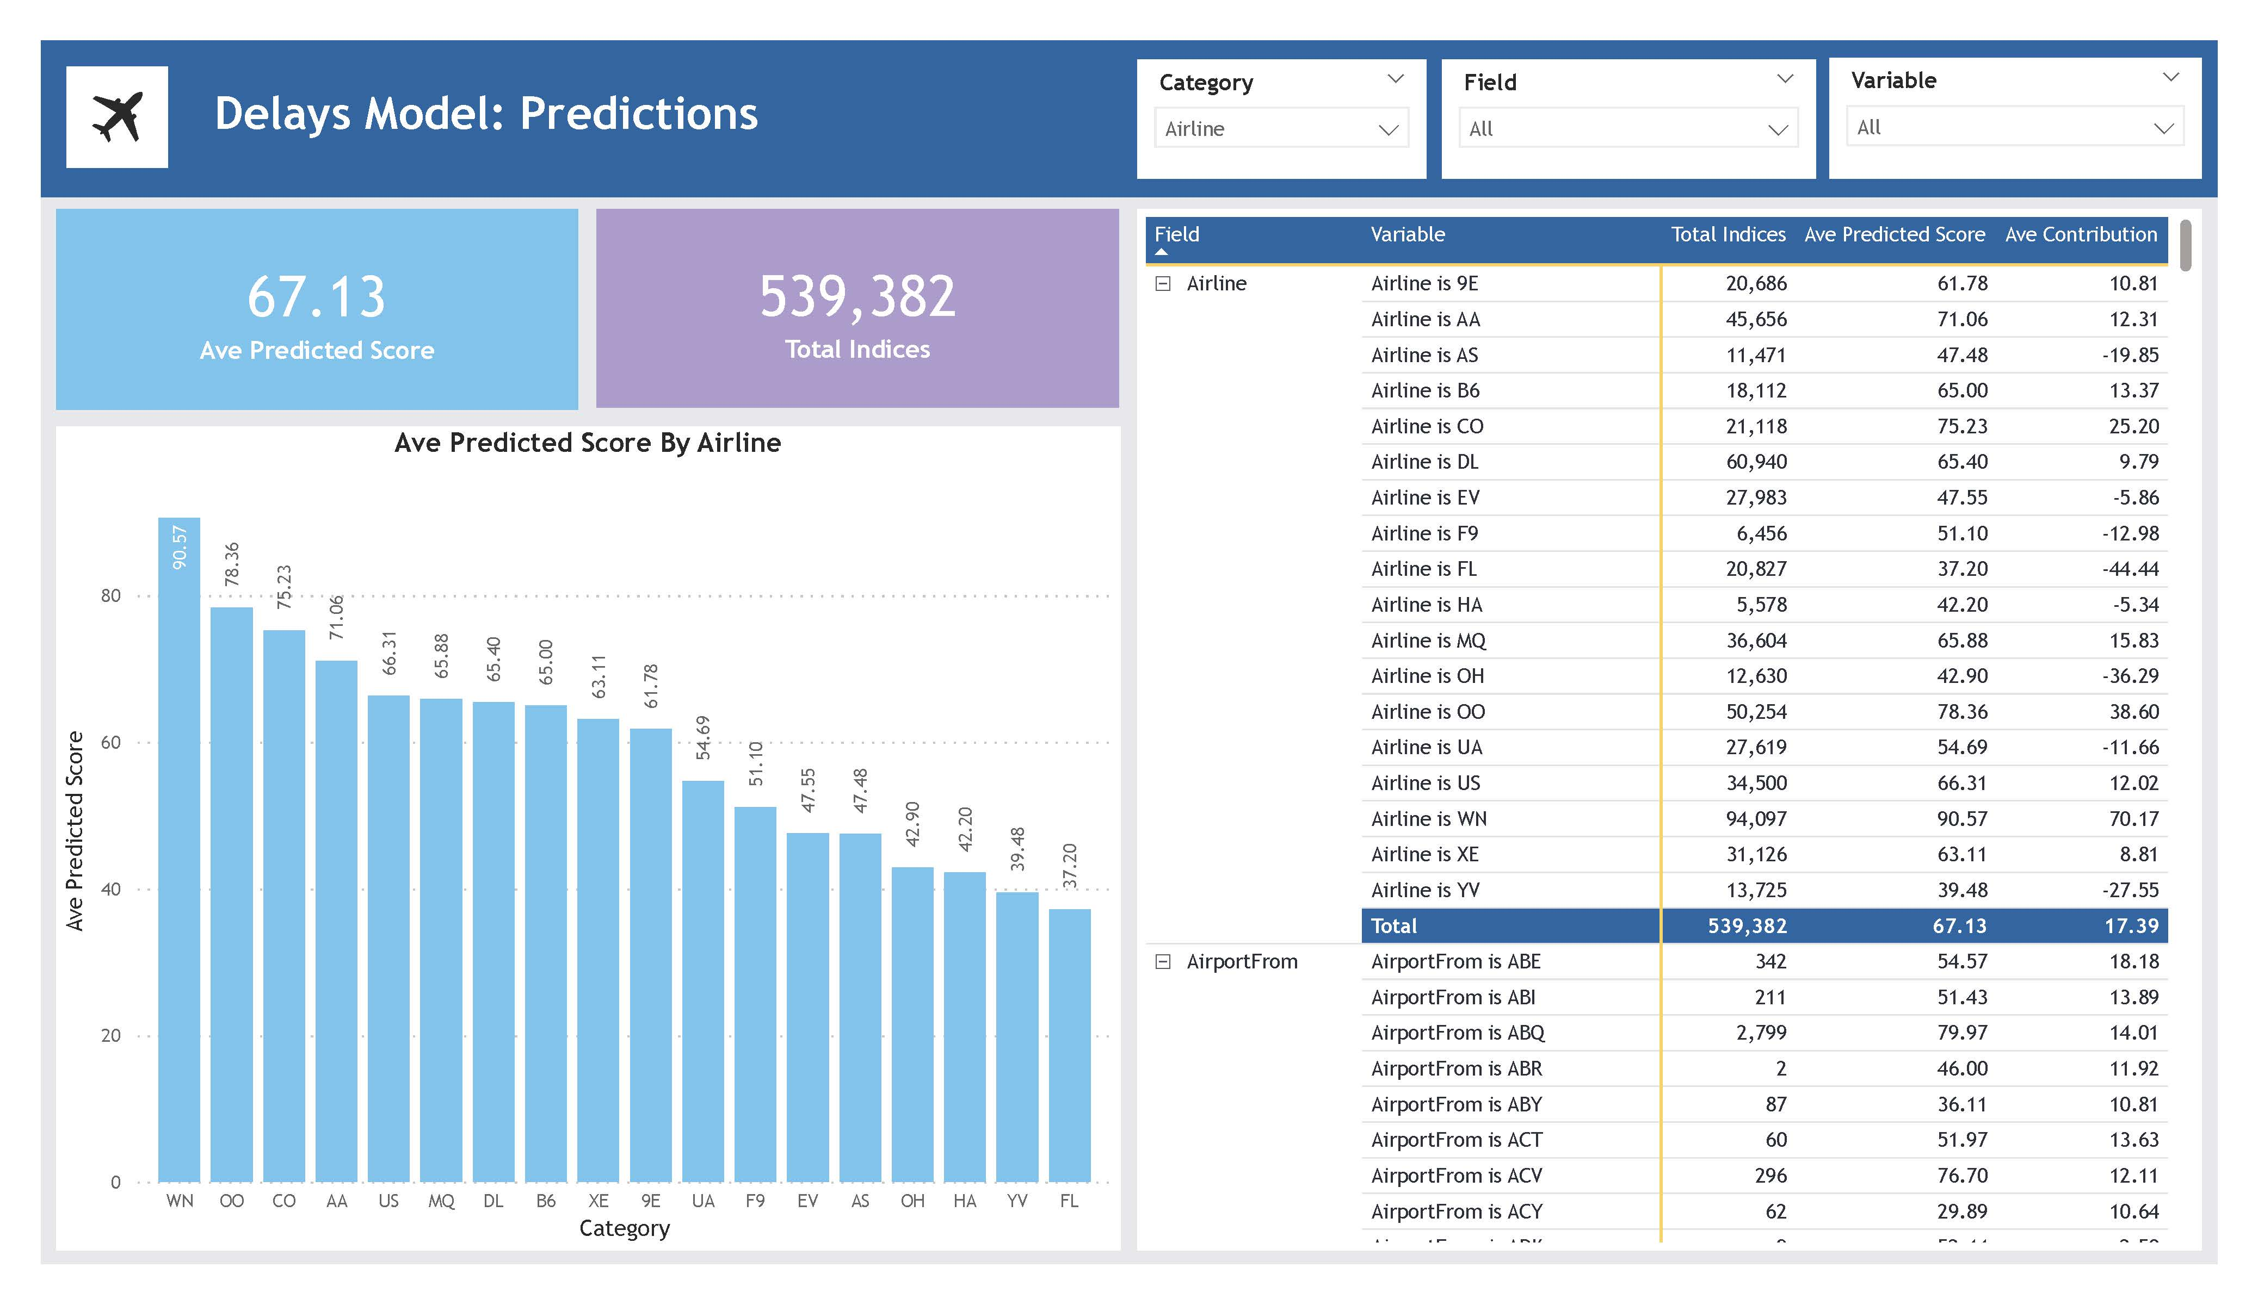



Load: Power BI Service
Transform: Data flows & Power Query
Build ML model
Extract: Excel File in Power BI Service
Build Report in Power BI Desktop
Publish App in Power BI Service
Airlines Delays Power BI ML

Slide 2
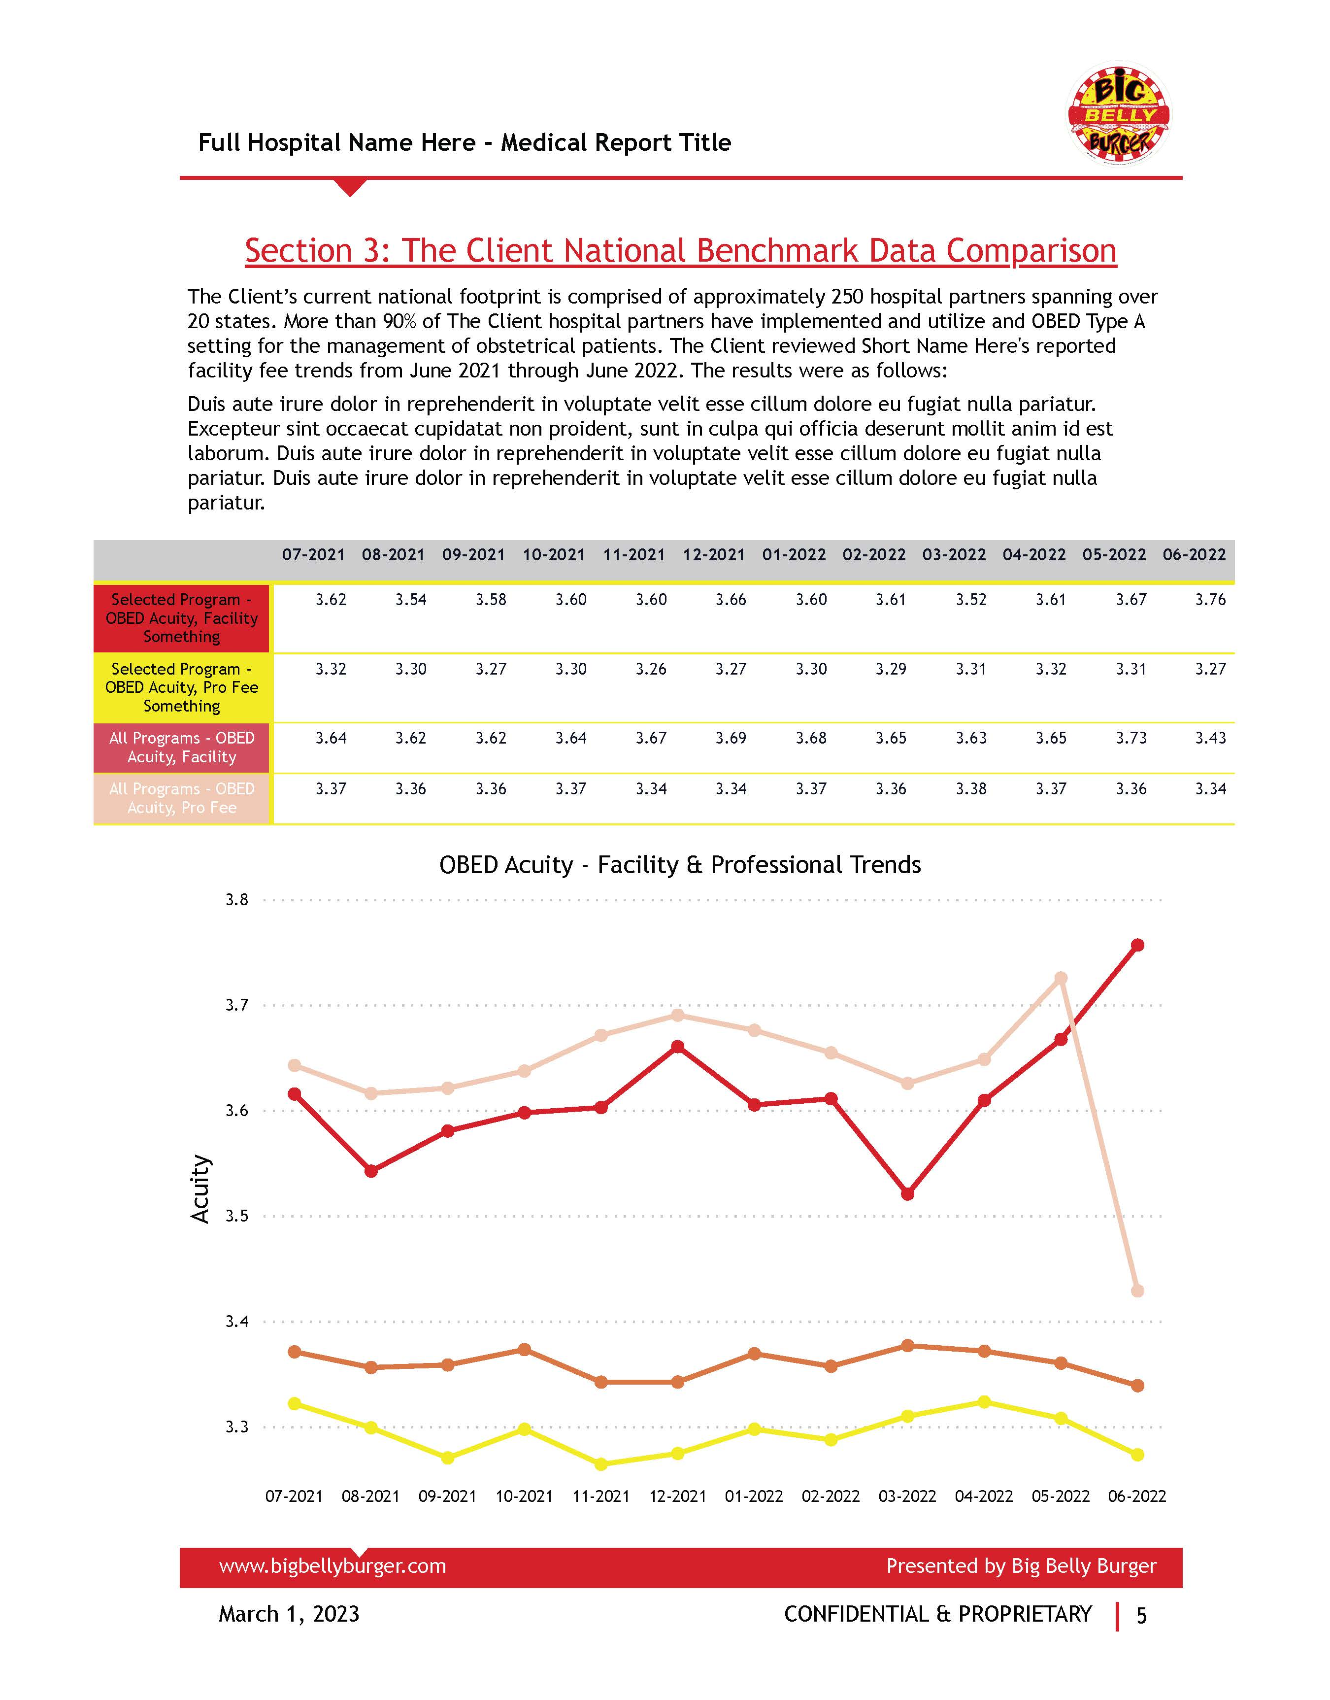

Extract: Excel File in Sharepoint
Load: Power BI
Transform: Power Query
Build Report
Publish App in Power BI Service
Automated Medical Financial Reporting

Slide 3
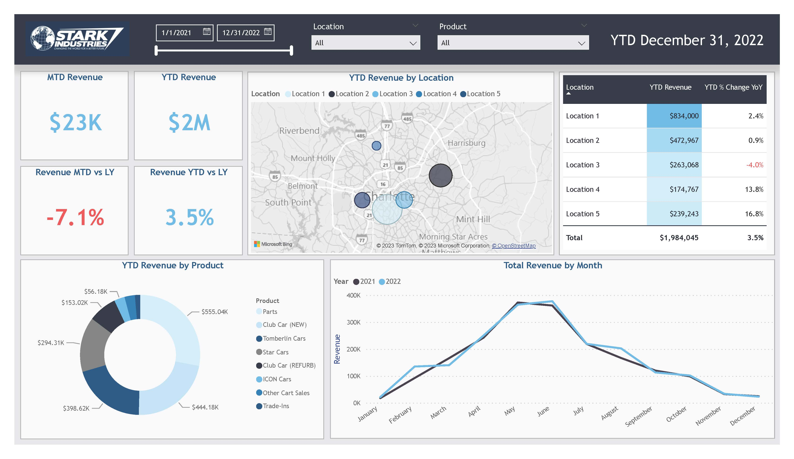
Extract: Excel File in Sharepoint
Load: Power BI
Transform: Power Query
Build Report
Publish App in Power BI Service
Client Proposal Dashboard

Slide 4
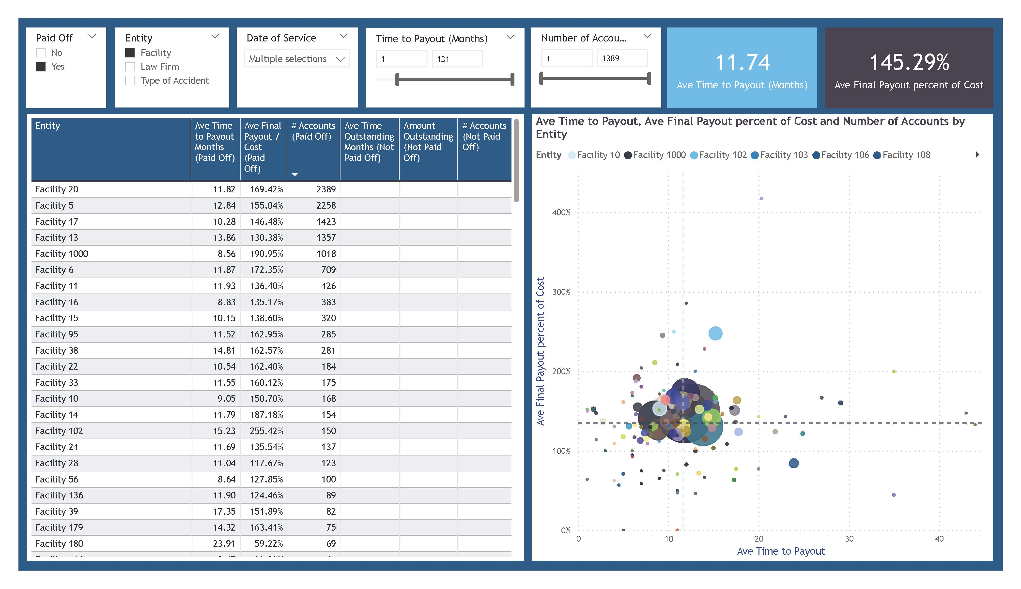
Extract: Excel File in Sharepoint
Load: Power BI
Transform: Power Query
Build Report
Publish App in Power BI Service
Current Client Analytics Demo

Slide 5
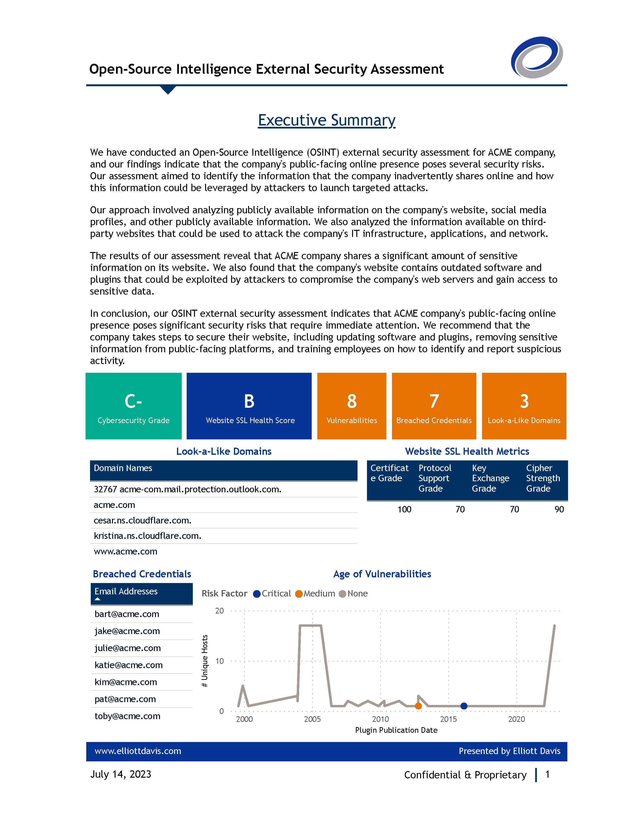
Extract: Excel File in Sharepoint
Load: Power BI
Transform: Power Query
Build Report
Cybersecurity Analytics Report

Slide 6
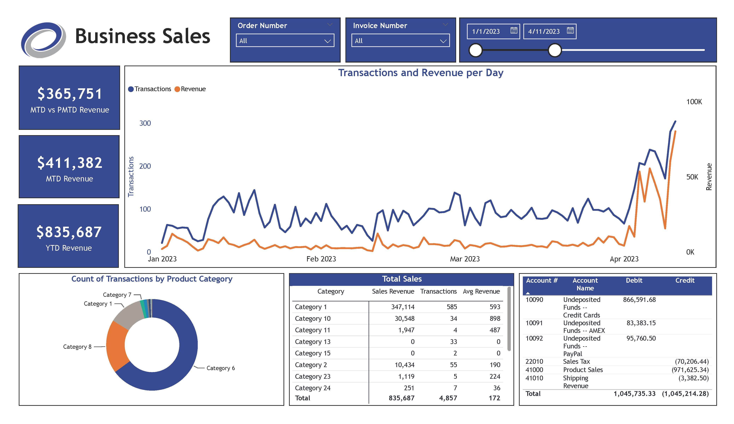

Extract: AWS S3
Load: Power BI
Transform: Power Query
Build Report
Publish App in Power BI Service
External Webinar Dashboards

Slide 7
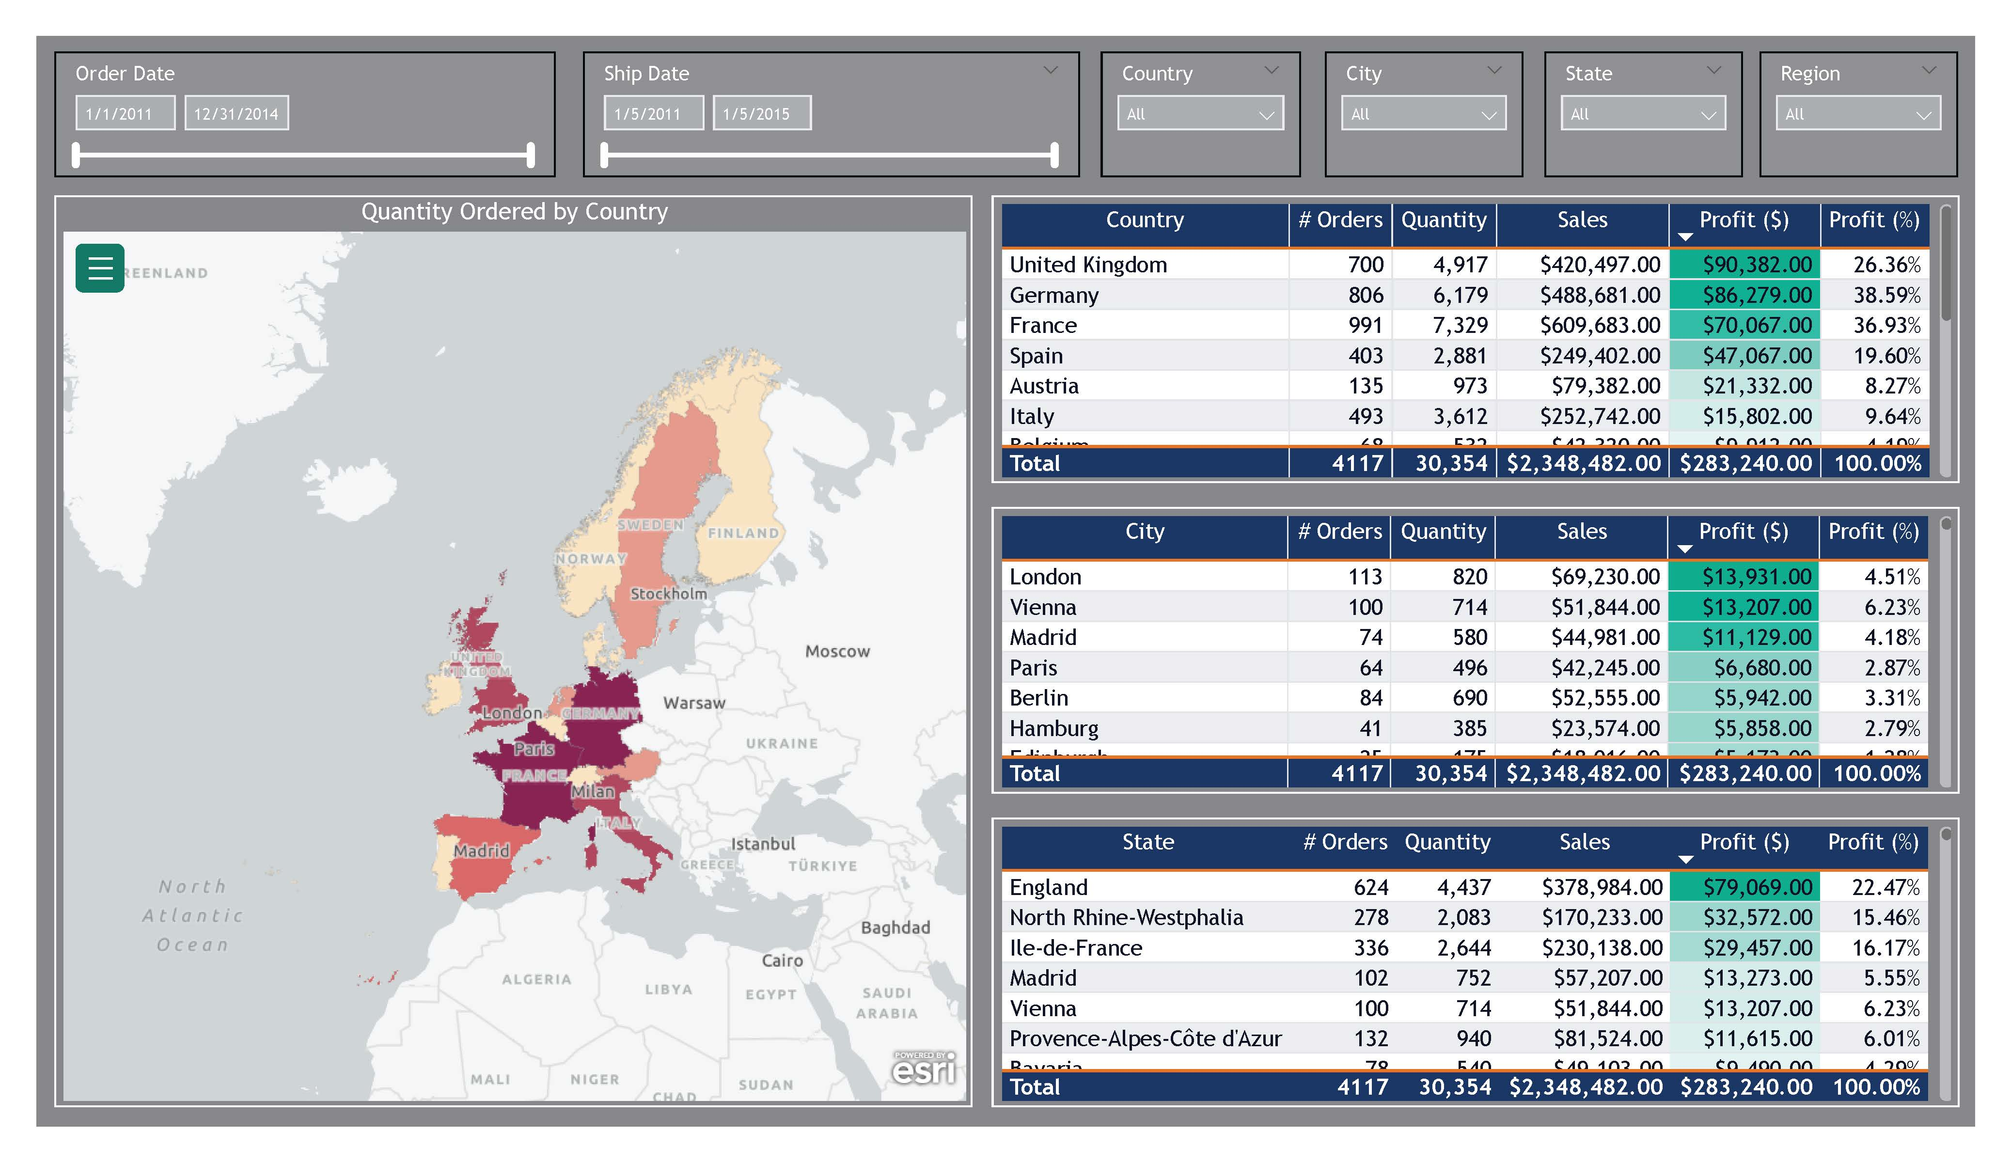
Extract: Excel File in Sharepoint
Load: Power BI
Transform: Power Query
Build Report
Publish App in Power BI Service
Group Case Study Demo

Slide 8
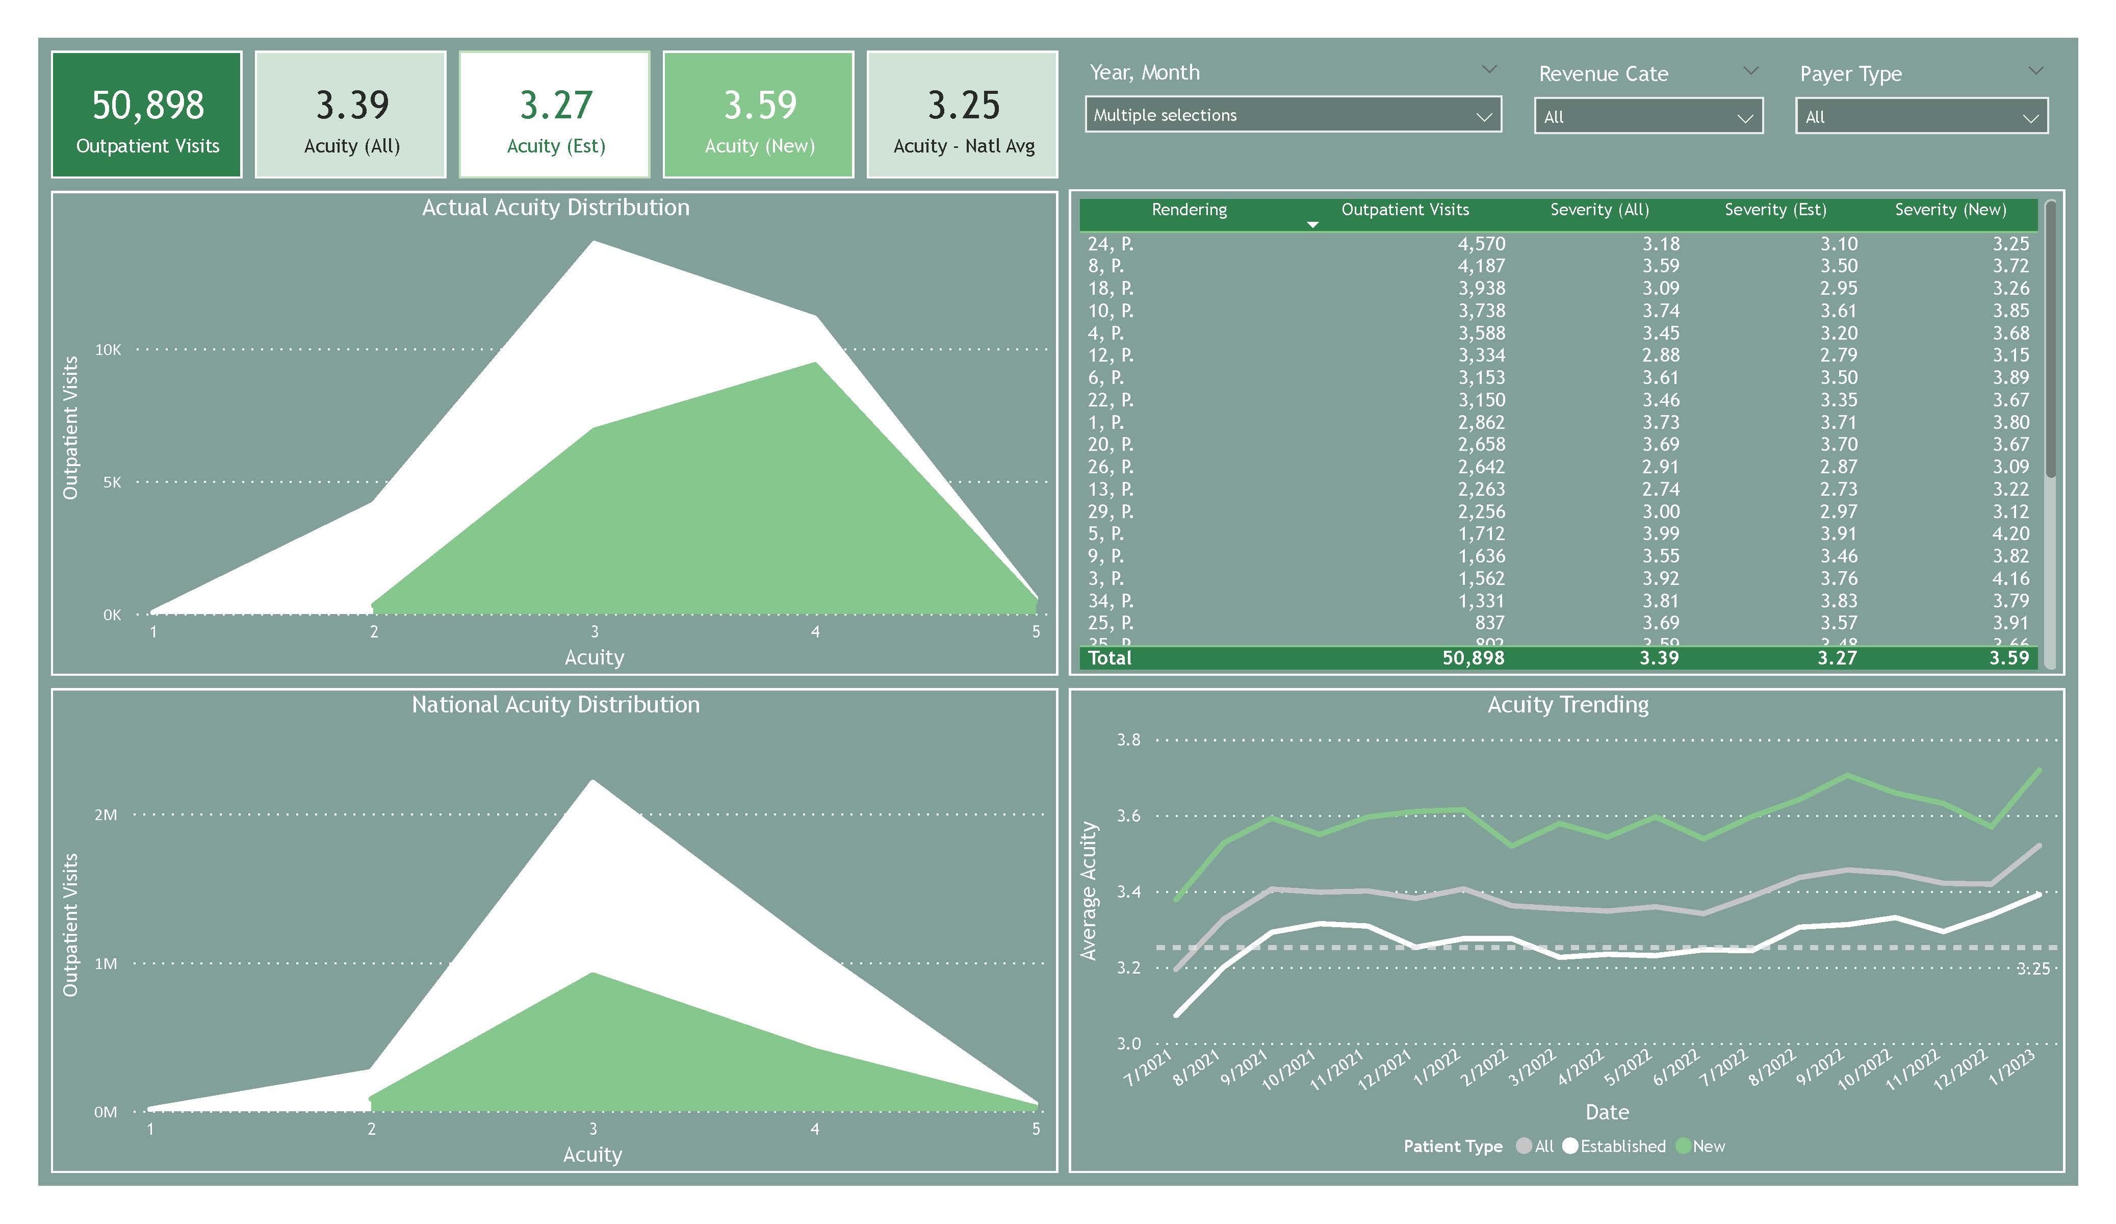
Extract: Excel File in Sharepoint
Load: Power BI
Transform: Power Query
Build Report
Publish App in Power BI Service
Healthcare Ongoing Dashboard

Slide 9
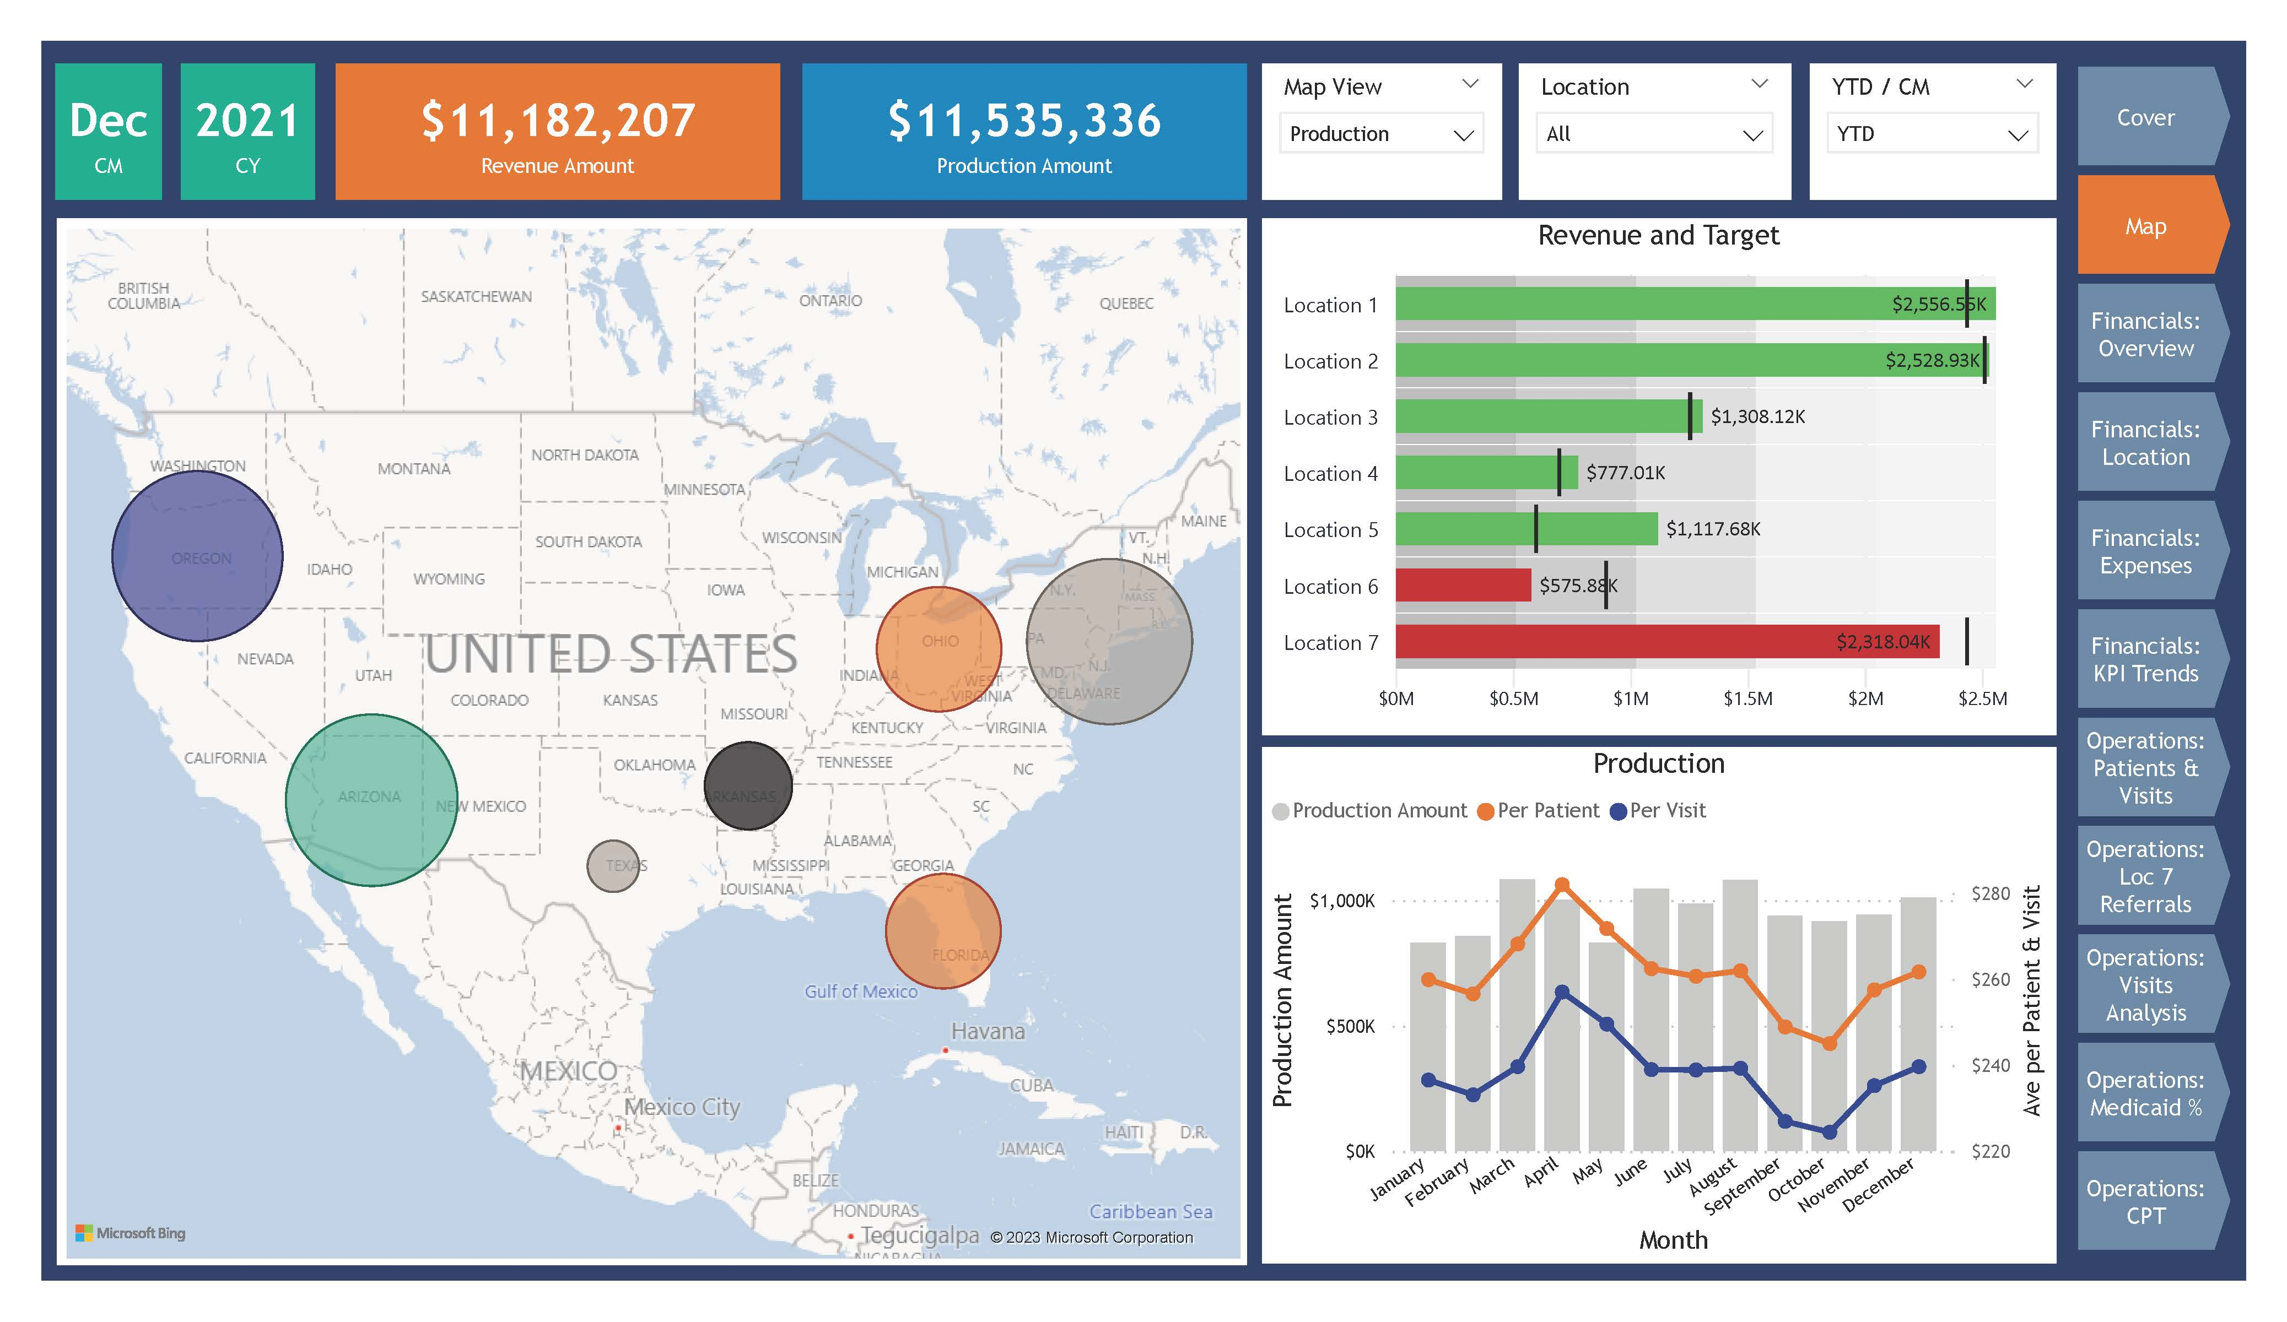
Extract: Excel File in Sharepoint
Load: Power BI
Transform: Power Query
Build Report
Healthcare Private Practice

Slide 10
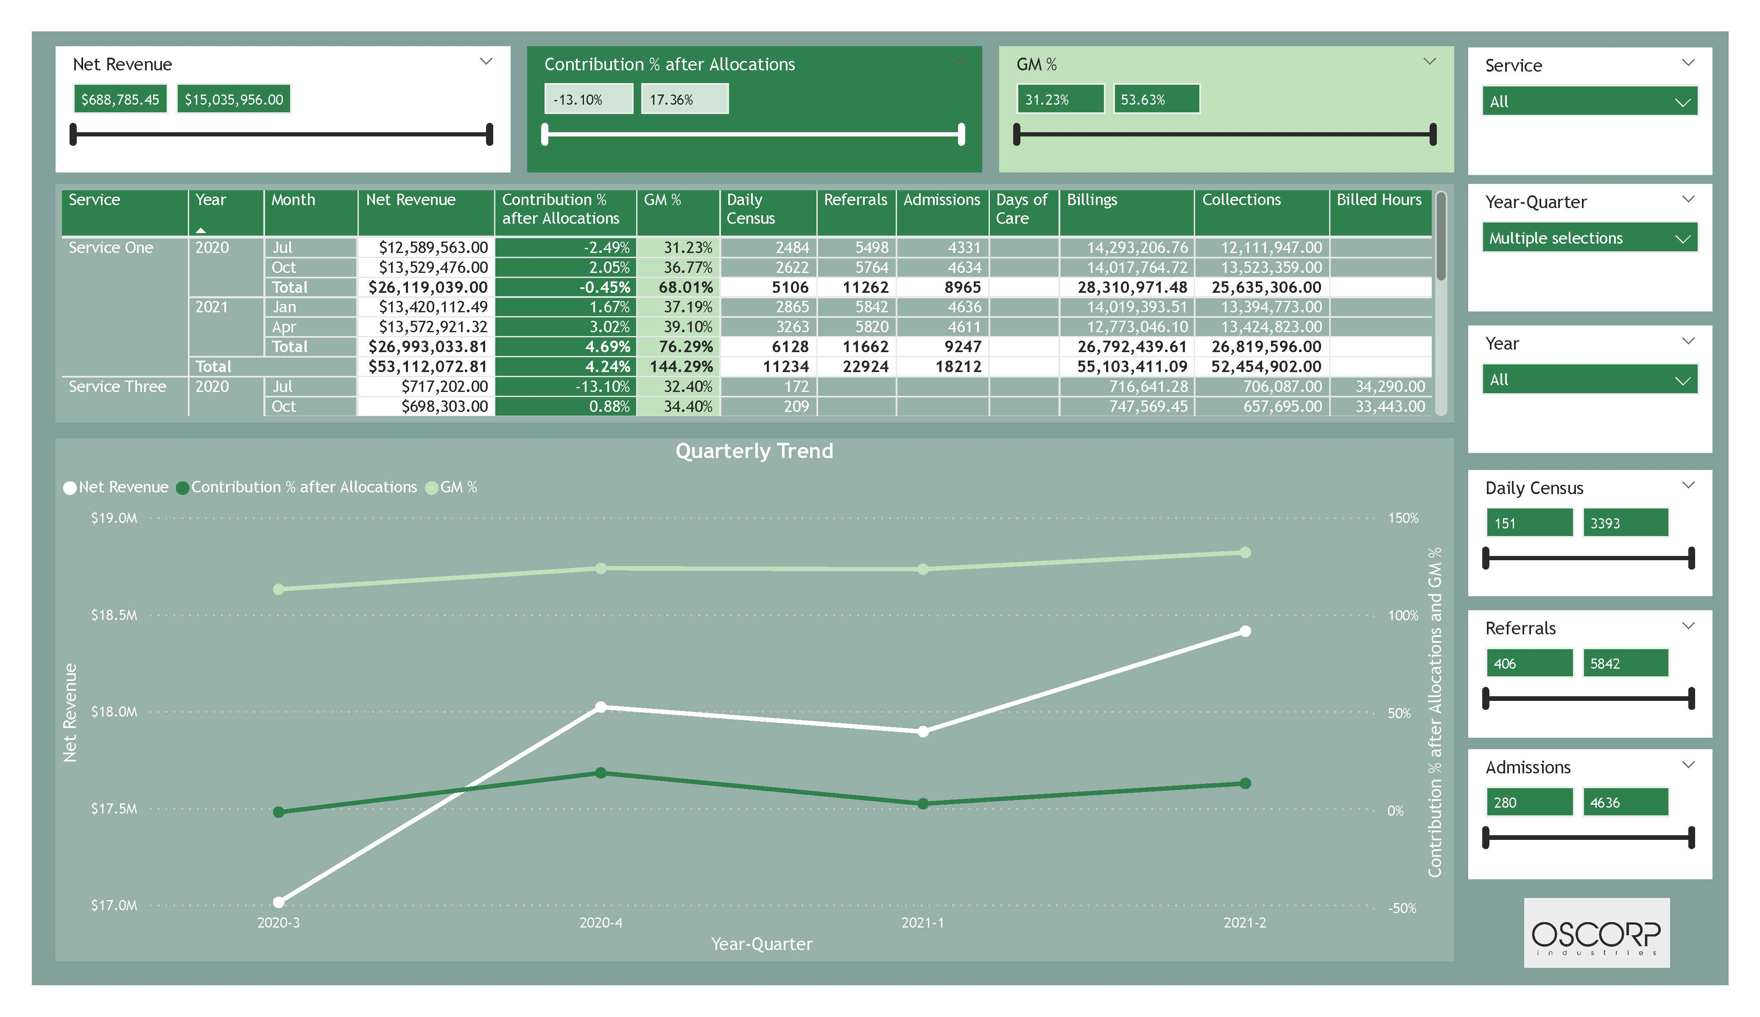
Extract: Excel File in Sharepoint
Load: Power BI
Transform: Power Query
Build Report
Healthcare Proposal Dashboard

Slide 11
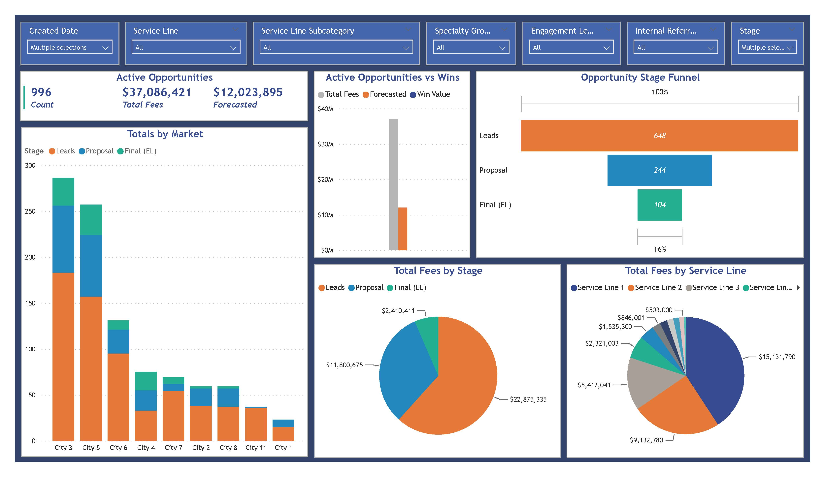

Extract: Smartsheet
Load: Power BI
Transform: Power Query
Build Report
Publish App in Power BI Service
Internal Use Work Tracker

Slide 12











Synapse Data Engineering
Synapse Data Science
Data Activator
Teams
API
Data Factory
Power BI
One Lake
Joshua Project Analytics

Slide 13

Synapse Data Engineering
Synapse Data Science
Data Activator
Teams
API
Data Factory
Power BI
One Lake
LEGO Rebrickable Analytics

Slide 14
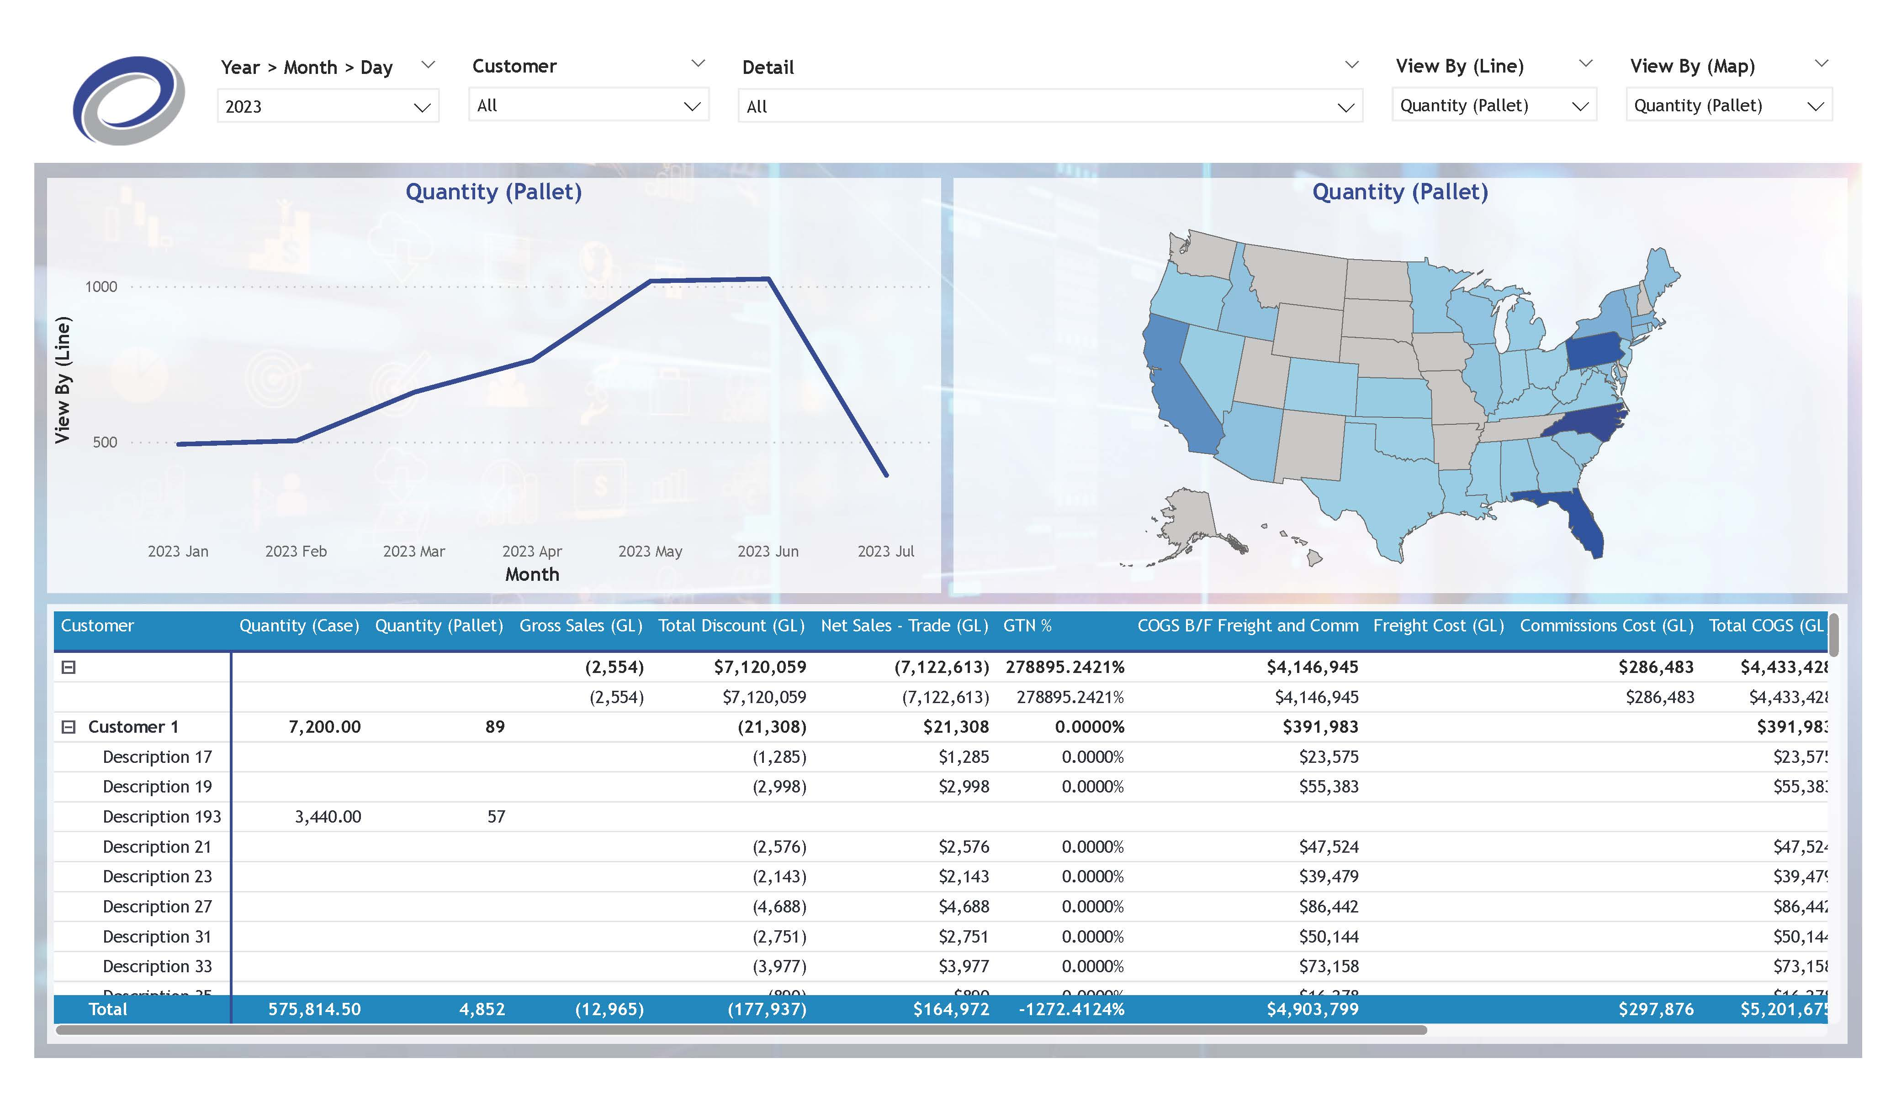

Extract: SQL Database
Load: Power BI
Transform: Power Query
Build Report
Publish App in Power BI Service
Manufacturing Client Demo

Slide 15
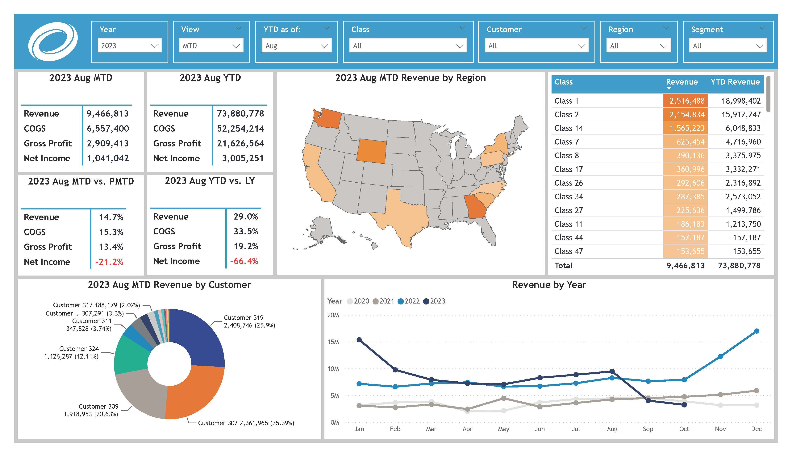

Extract: QuickBooks Online
Load: Power BI
Transform: Power Query
Build Report
Publish App in Power BI Service
Manufacturing QuickBooks Analysis

Slide 16
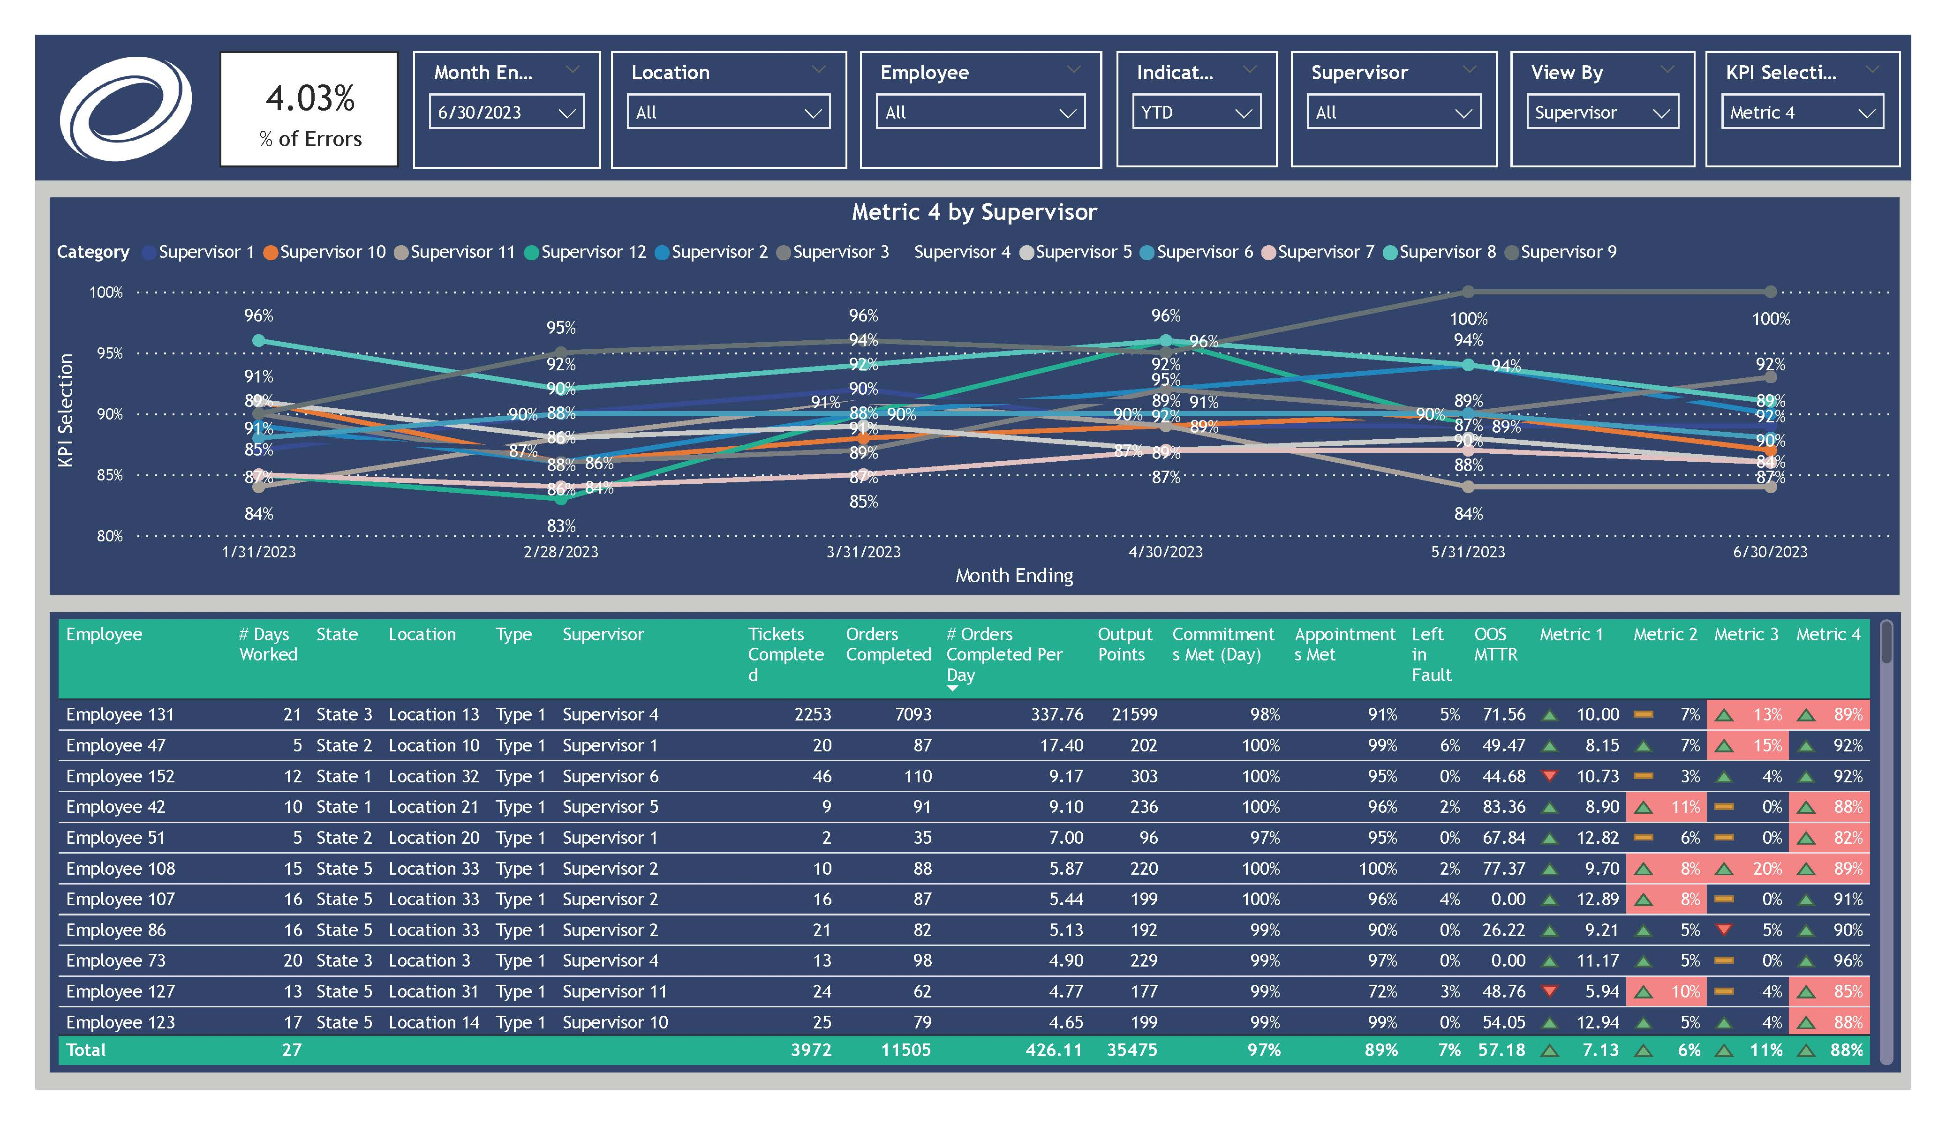
Extract: Excel File in Sharepoint
Load: Power BI
Transform: Power Query
Build Report
Publish App in Power BI Service
Manufacturing Supervisor Dashboards

Slide 17
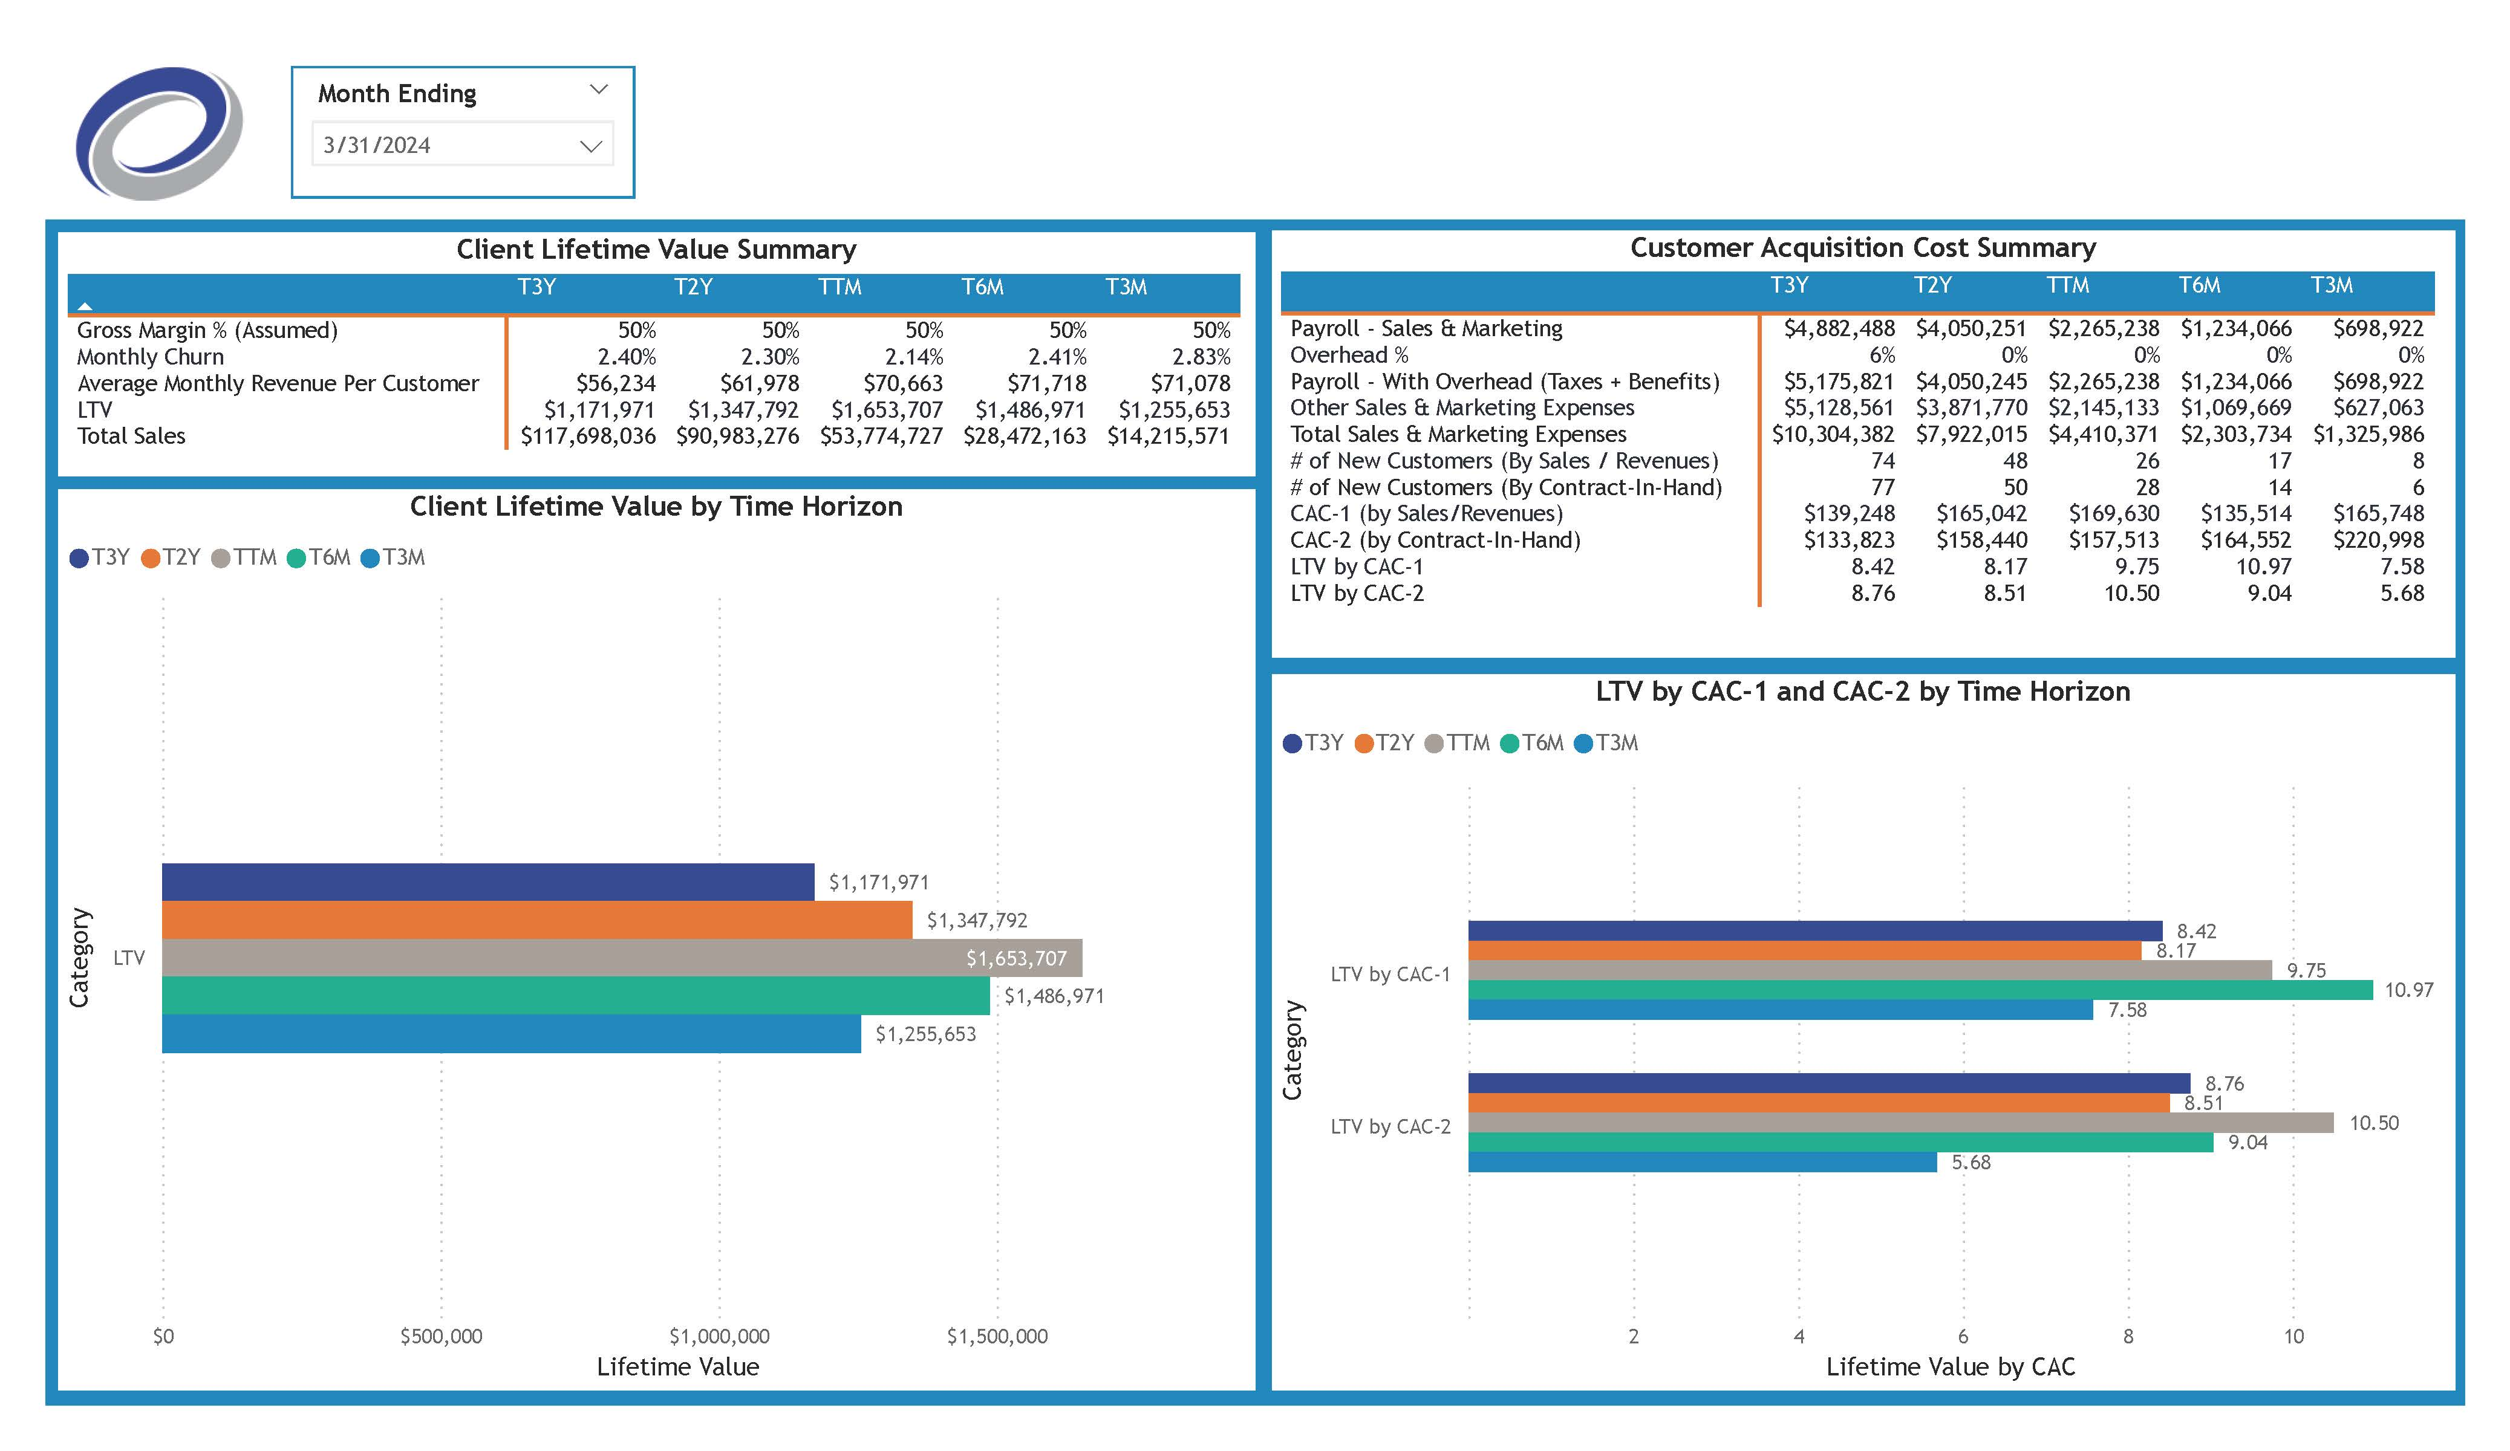

Load: Power BI
Transform: Power Query
Build Report
Publish App in Power BI Service
Extract: QuickBooks Online,
Salesforce,
And an Excel file in Sharepoint
Medical Billing Service Provider Dashboards

Slide 18
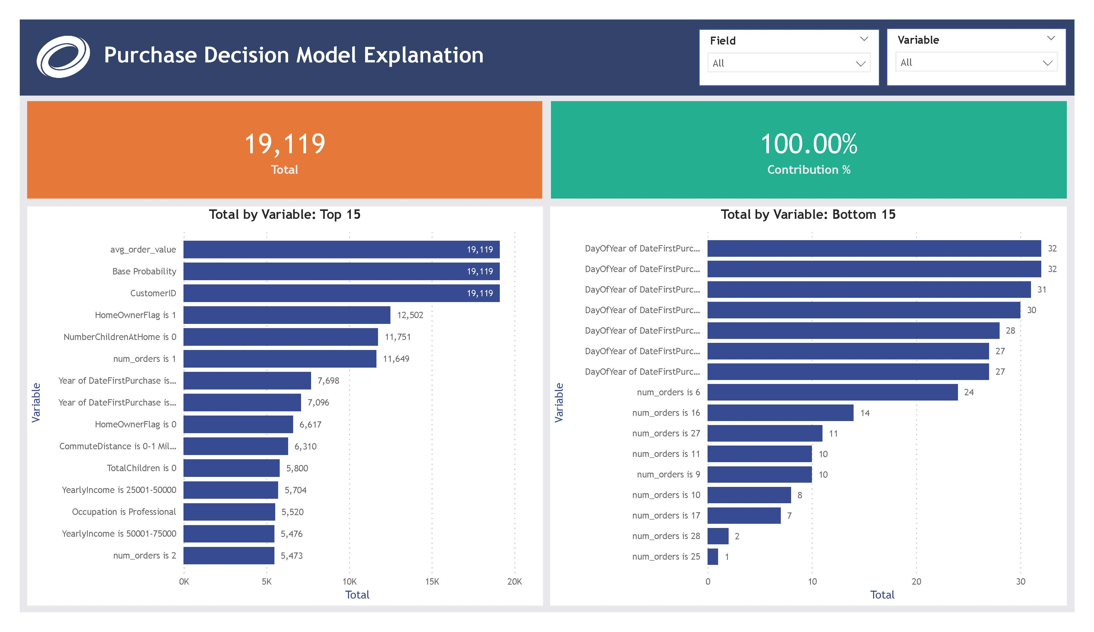
Load: Power BI Service
Transform: Data flows & Power Query
Build ML model
Extract: Excel File in Power BI Service
Build Report in Power BI Desktop
Publish App in Power BI Service
ML Tutorial Project

Slide 19
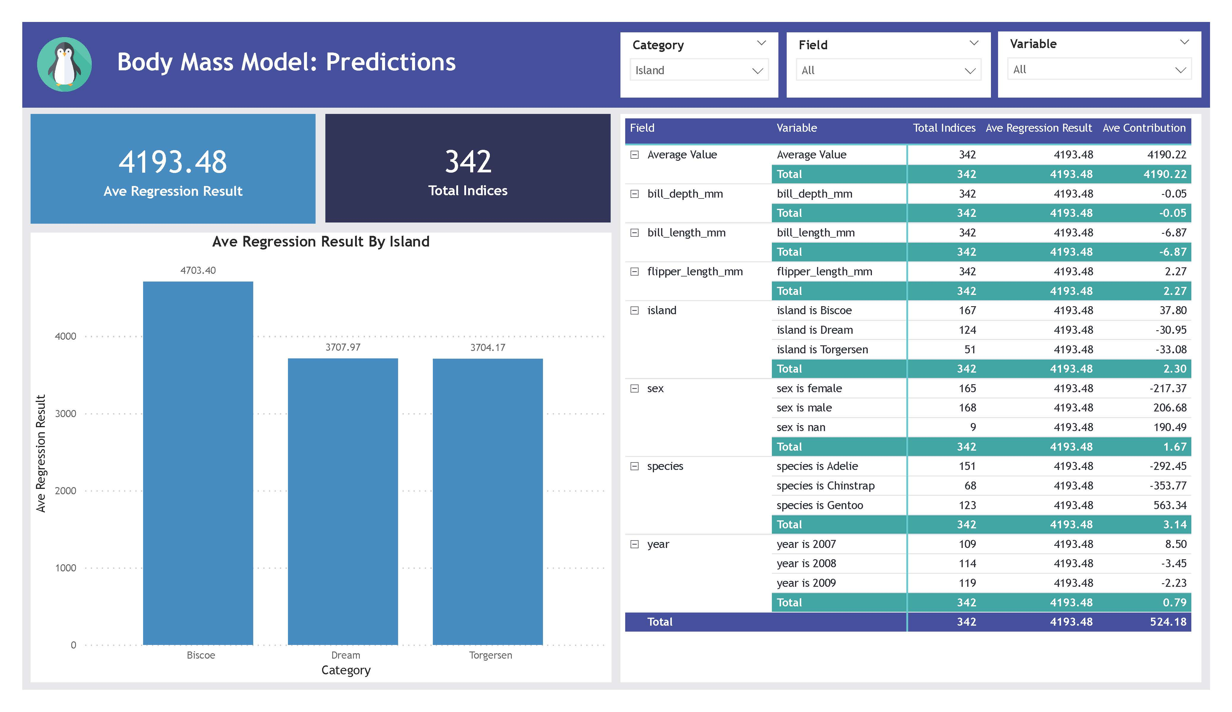
Load: Power BI Service
Transform: Data flows & Power Query
Build ML model
Extract: Excel File in Power BI Service
Build Report in Power BI Desktop
Publish App in Power BI Service
Penguins Power BI ML

Slide 20
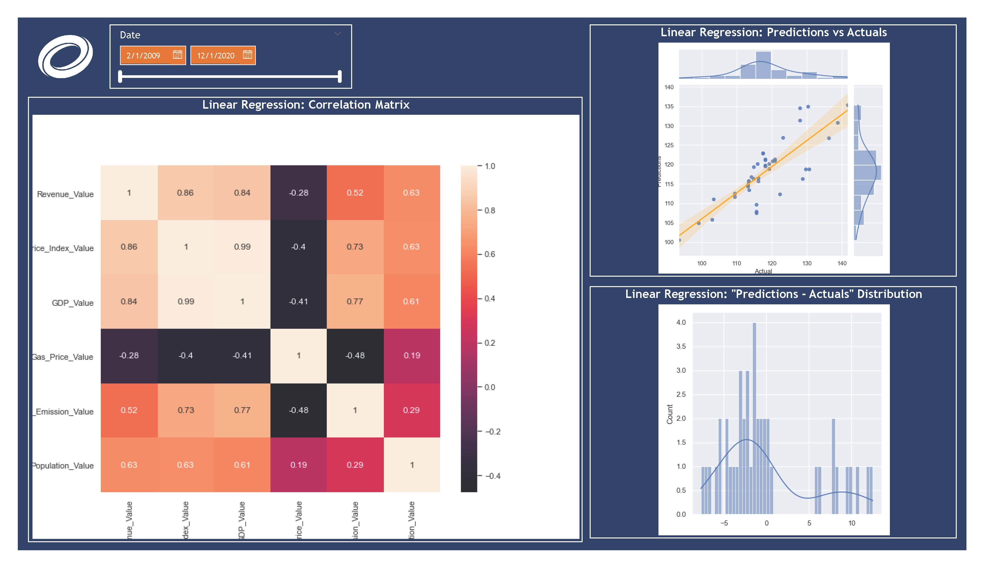

Extract: APIs and Web Scraping with Python
Load: Power BI
Transform: Power Query
Build Report
Extract: Excel File
Power BI + Python + Machine Learning Forecasting

Slide 21
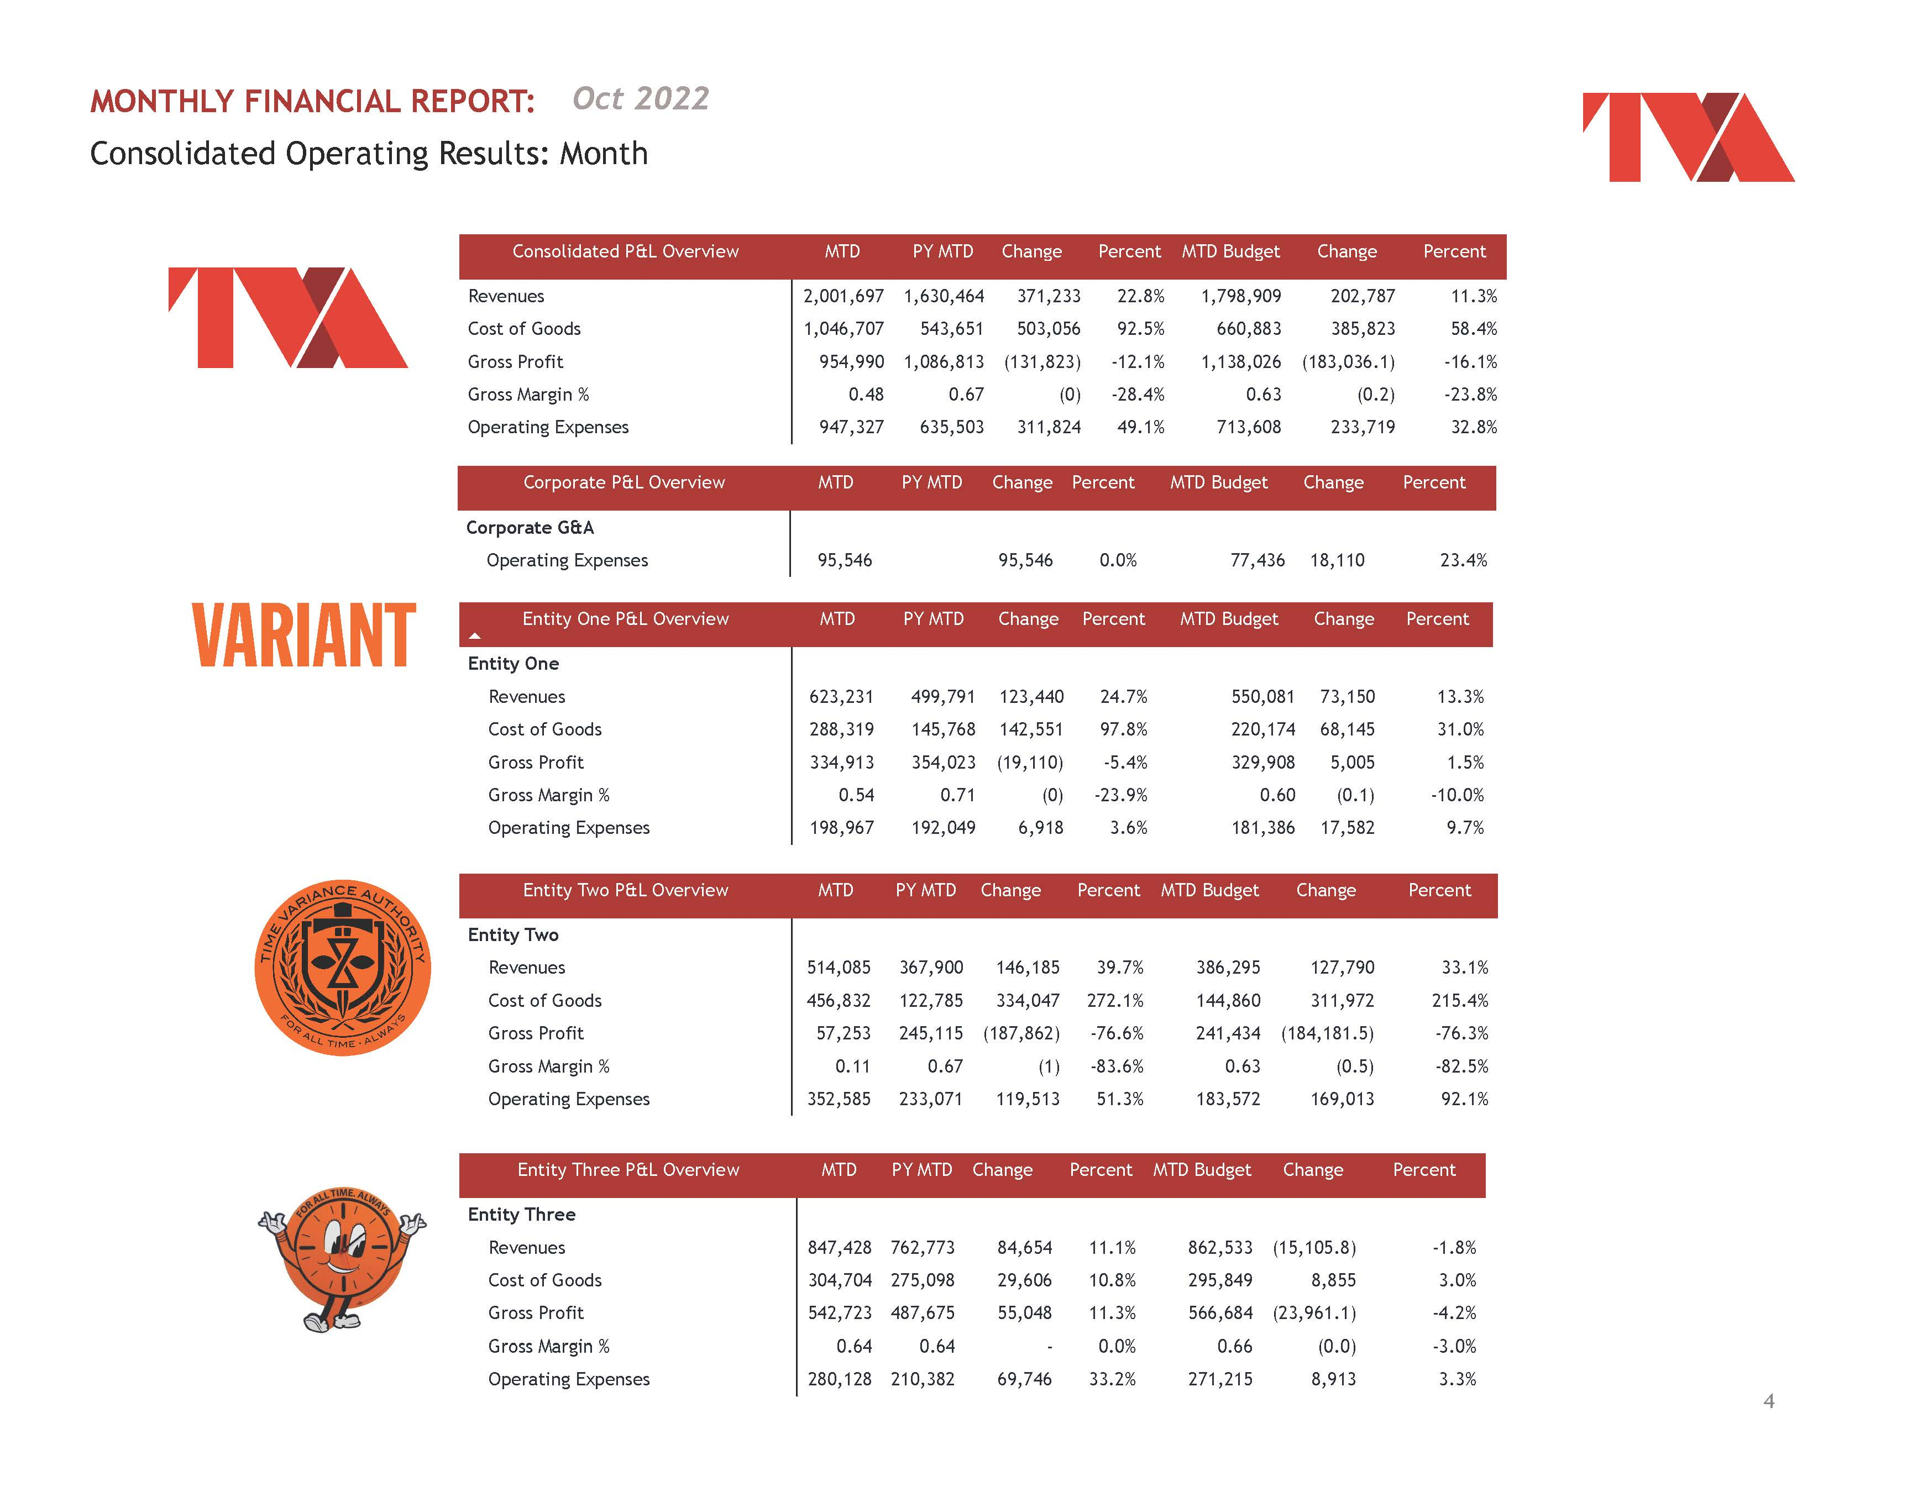
Extract: Excel File in Sharepoint
Load: Power BI
Transform: Power Query
Build Report
Private Equity Financial Reporting Automation

Slide 22
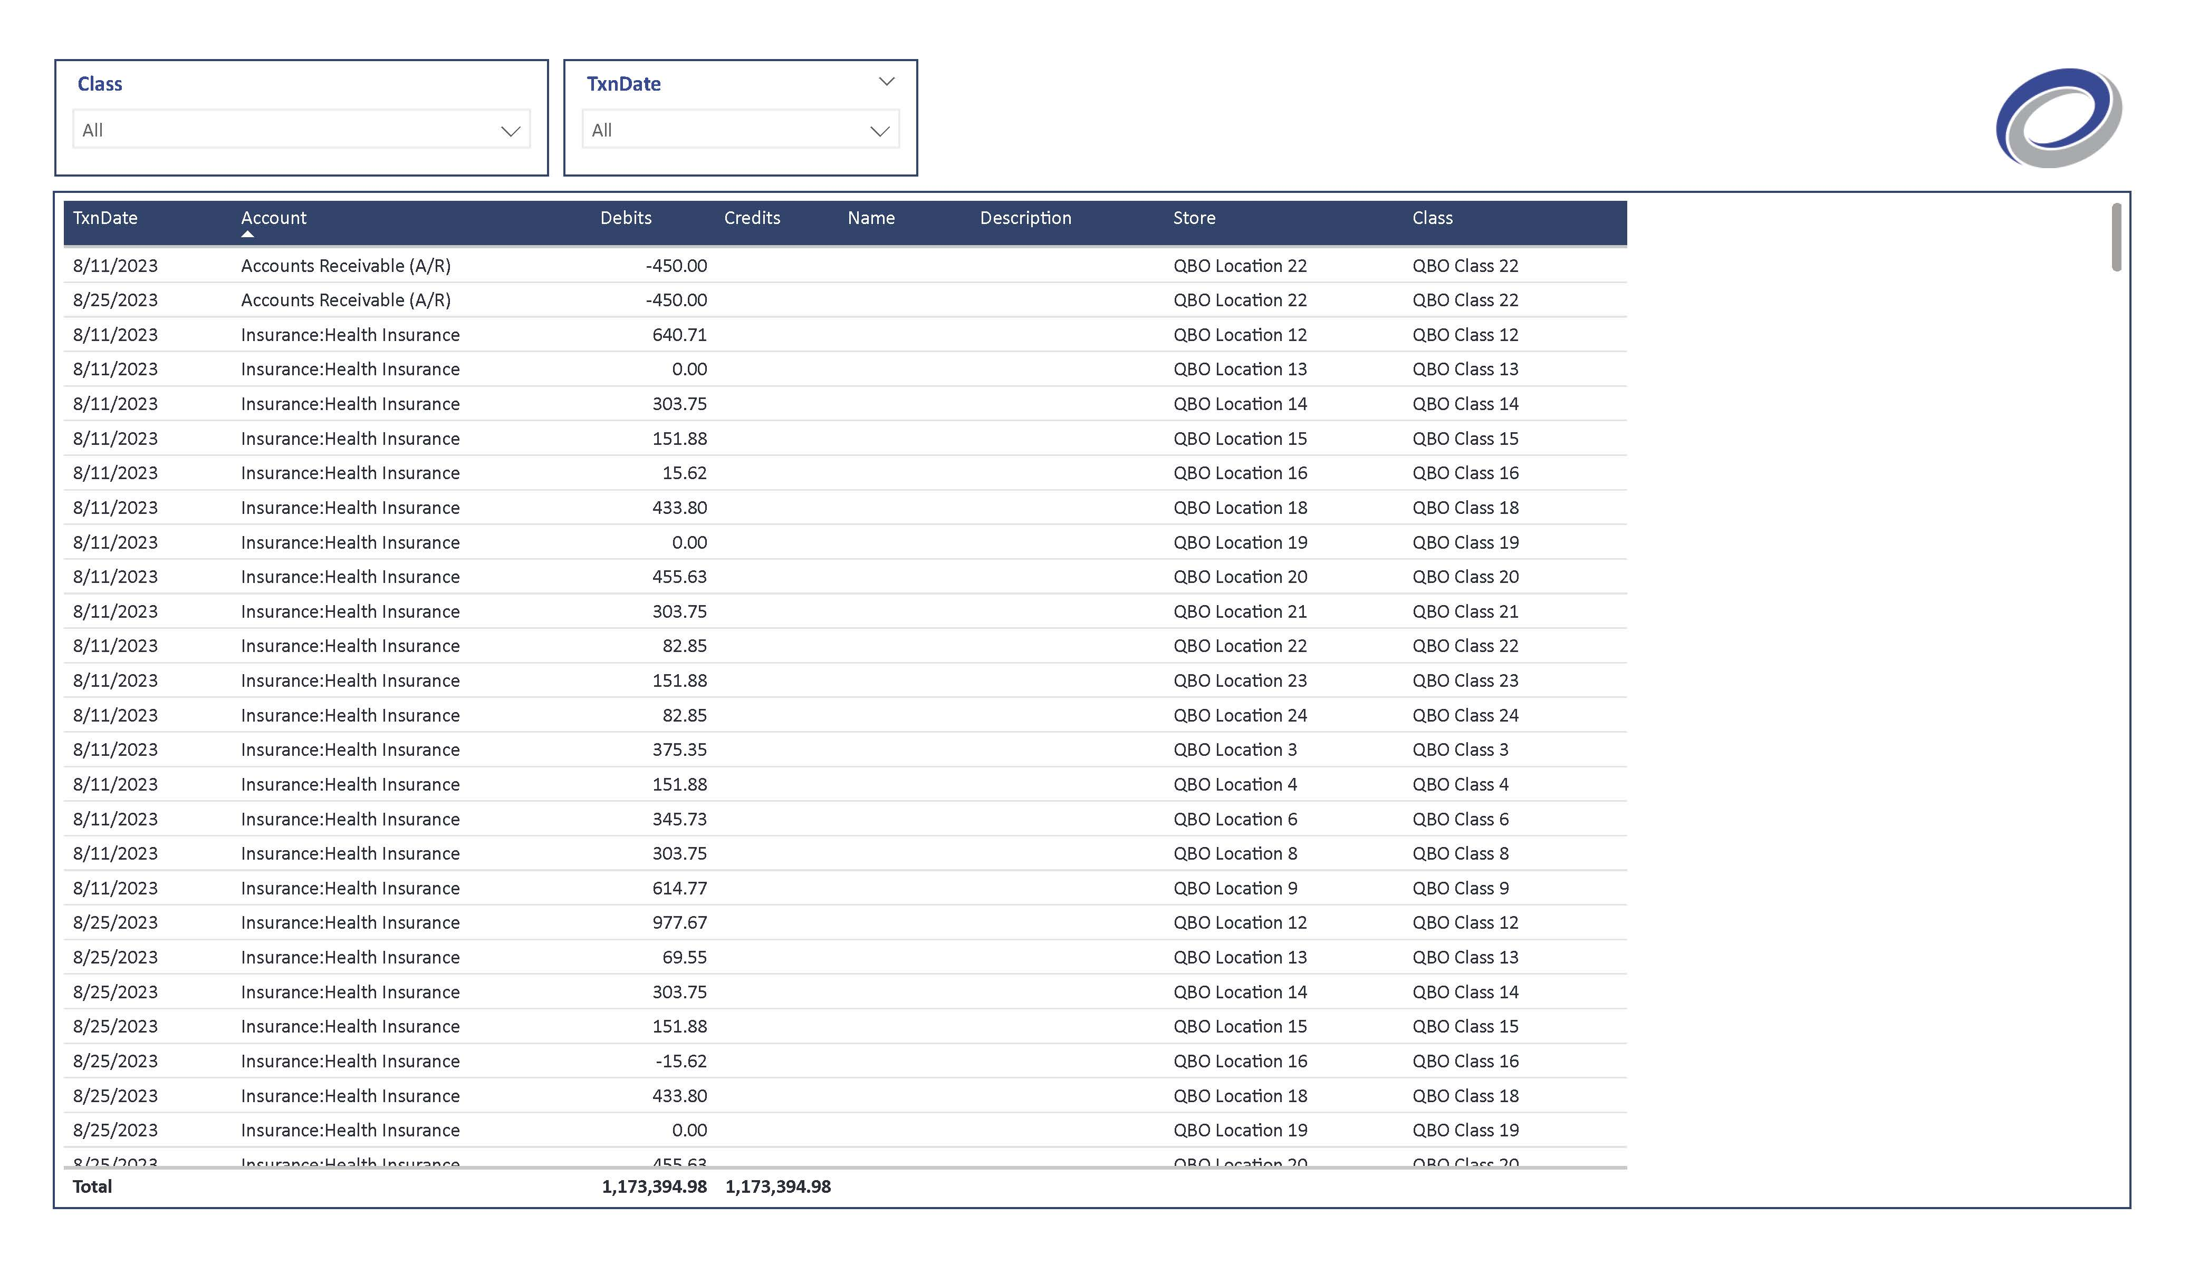
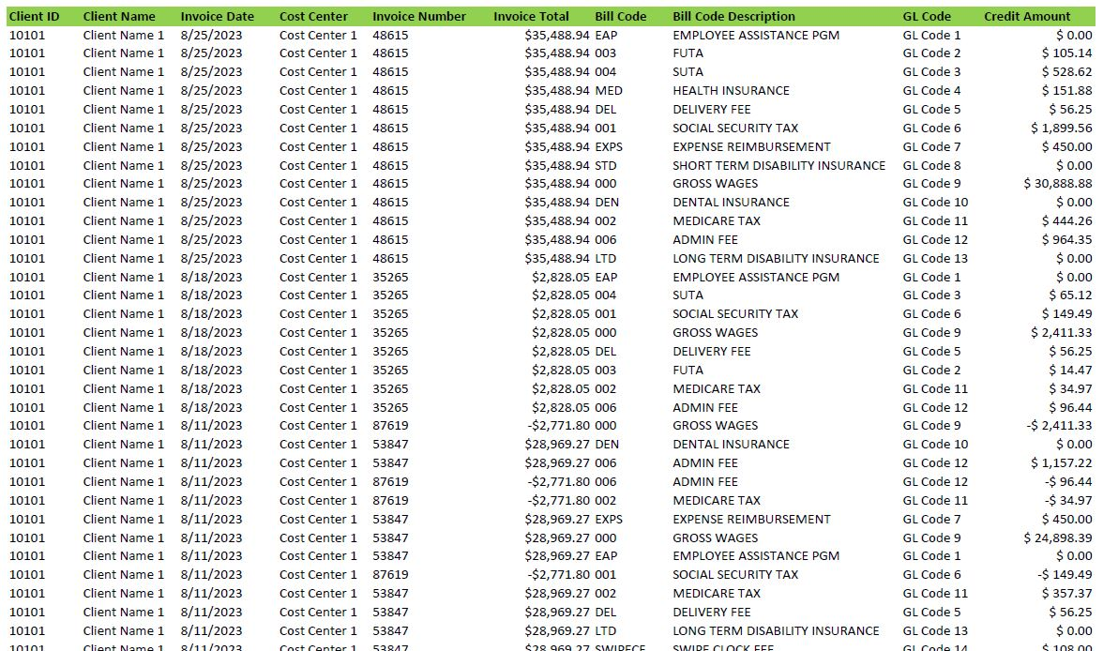
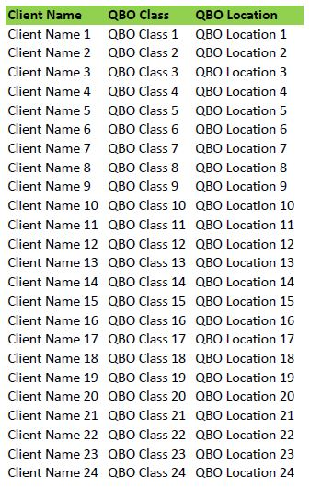
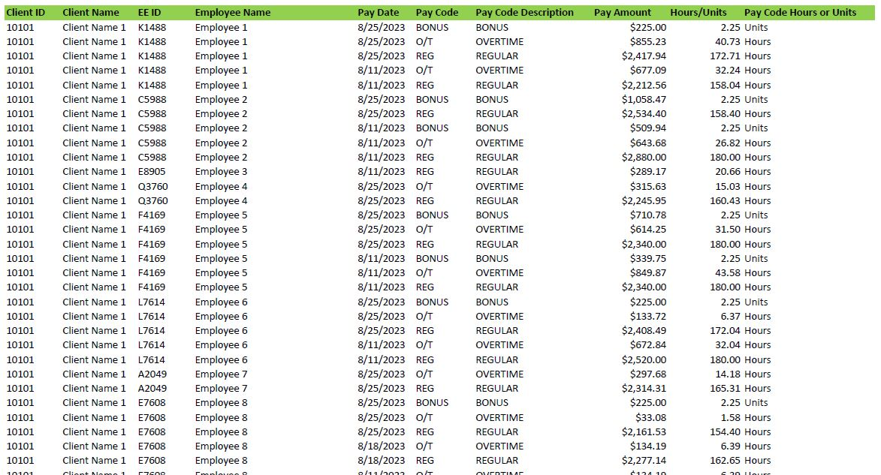
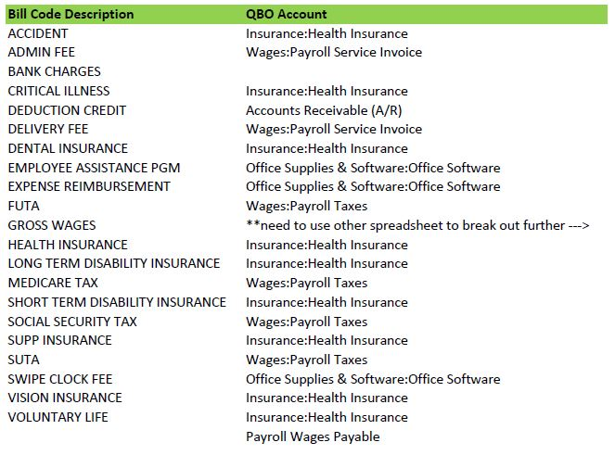
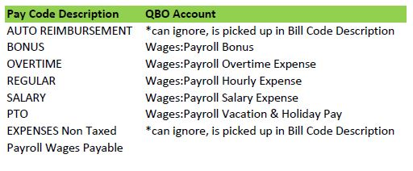
Extract: 2 payroll reports & 3 mapping tables saved in Excel
Load: Power BI
Transform: Power Query
Build final result for import
QBO Payroll Import Automation

Slide 23
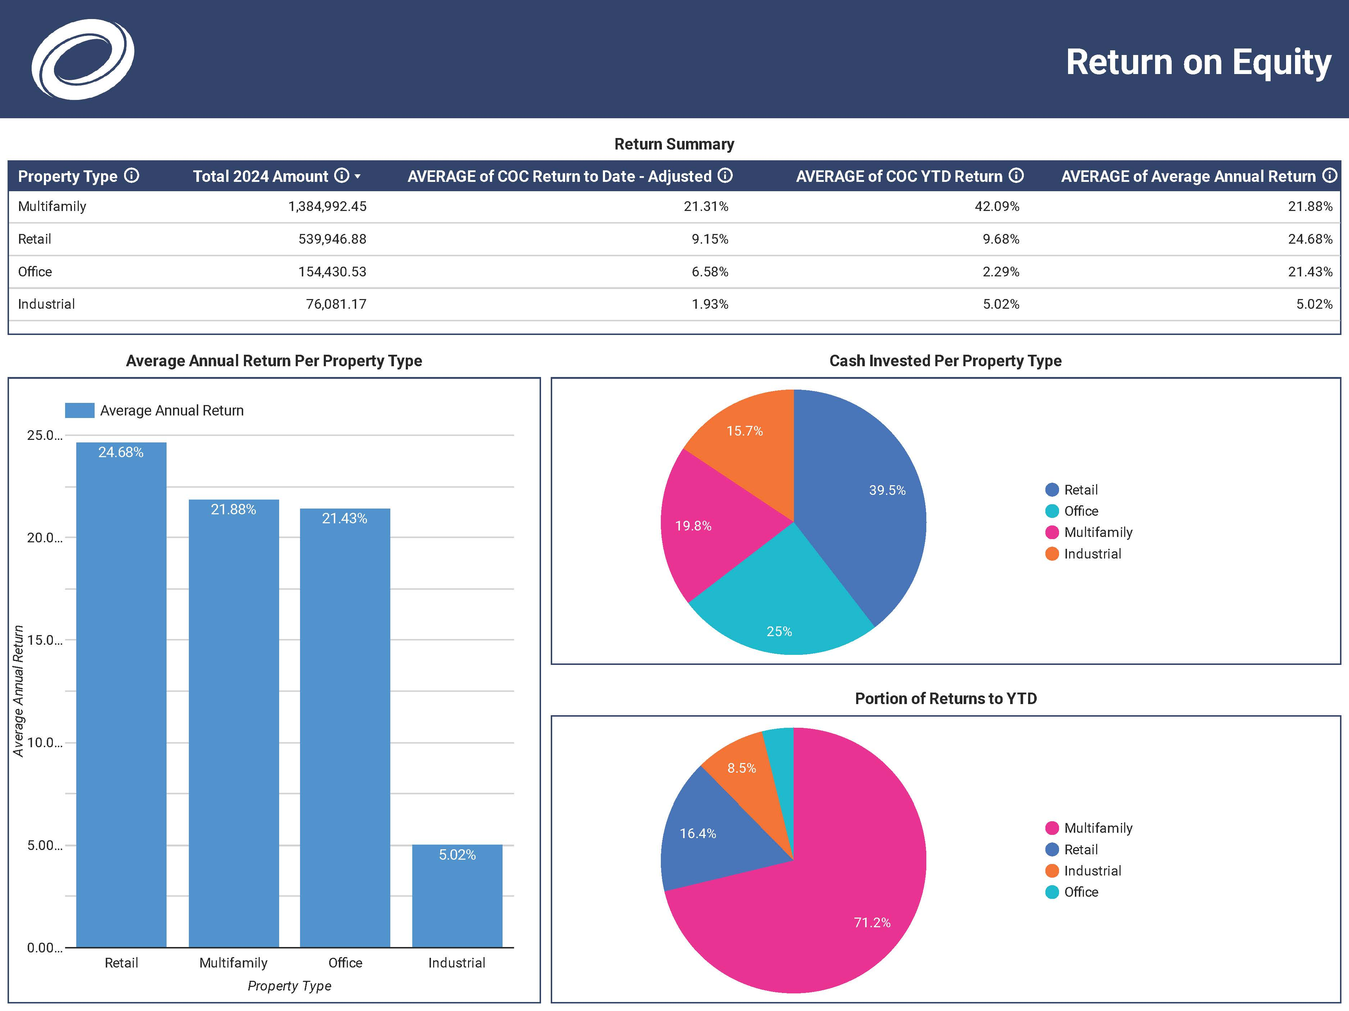



Extract reports from Appfolio property manager into
Google Sheets
Load: Google Looker
Build Report
Real Estate Client Dashboards

Slide 24

Synapse Data Engineering
Synapse Data Science
Data Activator
Teams
API
Data Factory
Power BI
One Lake
Recreation.gov Analytics

